Slide 1


American Fisheries Society
Professional Certification Program
Est. 1 July 1998.

Slide 2
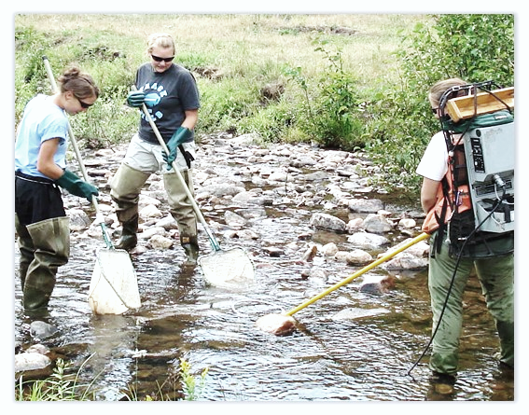
AFS Professional Certification Objectives
To provide governmental and nongovernmental agencies and organizations, private firms, courts, and the general public with a definitive minimum standard of experience and education for fisheries professionals
To foster broader recognition of fisheries professionals as well-educated and experienced, acting in the best interest of the public.

Slide 3
Why should I get certified as a “Fisheries Professional”
Provide expert witness
    Provide scientific facts + professional opinion
Some state employers require or desire certification for employment or promotion
Shows employers you are seriously interested in a career in fisheries
Click here to read more

Slide 4
Levels of Certification
I. Associate Fisheries Professional (AFP)—Applicants must meet the academic (course and degree) requirements as prescribed under Guidelines for Professional Certification.
  Associate Fisheries Professional certification may be retained for a maximum of eight years, at which time the requirements for a Certified Fisheries Professional must be met and applied for in order to retain any AFS certification. The AFP must submit a new application with all requested information, with the exception of the course list and transcripts (unless further education has been acquired).
II. Certified Fisheries Professional (CFP) and Certified Fisheries Professional (FP-C) (applying as established fisheries professional) — In addition to the academic requirements mentioned above, minimum experience and professional development requirements are listed under Guidelines for Professional Certification.
III. Emeriti — Individuals who held the FP-C designation for at least twenty (20) years (need not be consecutive) and who are employed less than full time or are retired, may request emeriti status through which they can maintain their FP-C status without the renewal requirement. Successful female applicants receive emeriti status while successful male applicants receive emeritus status. Applicants must provide your certification number and initial date of certification (must have been certified for at least 20 years).

Slide 5
Requirements for Certification
Be an AFS member
Have an appropriate degree/s (BS, BA, MS, PhD) in Fisheries or a related field
Meet coursework requirement in the following subject areas:
    Fisheries and Aquatic Sciences
    Other Biological Sciences
    Physical Sciences
    Mathematics and Statistics
    Communications
    Human Dimensions
Have appropriate professional experience
  Amount of experience depends on highest degree attained
    Not required for Associate level (FP-A)
Recently earned enough Professional Development Quality Points (PDQPs)
  Not required for Associate level (FP-A) or Emeriti status

Slide 6
Certification, graduation before July 1, 2002
Degree & Experience | Coursework (Area – credits) | PDQP Timeframe | # of PDPQs |  | Fee
Associate Fisheries Professional (FP-A)
BS or BA No experience required | A-12, B-18, C-15, D-6 E-6 | N/A Credits are semester; (sem * 1.5) ~ quarter |  | NONE | $50
Certified Fisheries Professional (FP-C)
BS/BA + 5 yrs MS + 4 yrs PhD + 2 yrs | A-12, B-18 C-15, D-6 E-6 | Previous 2 years |  | 30 | $100
Upgrade from FP-A to FP-C
BS/BA + 5 yrs MS + 4 yrs PhD + 2 yrs | Previous FP-A designation | Previous 2 years |  | 30 | $50
Where “A” + Fisheries & Aquatic Sciences; “B” = Other Biological Sciences; “C” = Physical Sciences; “D” = Mathematics and Statistics; “E” = Communications

Slide 7
Certification, graduation after July 1, 2002
Degree & Experience | Coursework (Area – credits) | PDQP Timeframe | # of PDPQs |  | Fee
Associate Fisheries Professional (FP-A)
BS or BA No experience required | A*-12 D-6 B-18 E-9 C**-15 F-6 | N/A |  | NONE | $50
Certified Fisheries Professional (FP-C)
BS/BA + 5 yrs MS + 4 yrs PhD + 2 yrs | A-12 D-6 B-18 E-9 C-15 F-6 | Previous 2 years |  | 30 | $100
Upgrade from FP-A to FP-C
BS/BA + 5 yrs MS + 4 yrs PhD + 2 yrs | Previous FP-A designation | Previous 2 years |  | 30 | $50
Where “A” + Fisheries & Aquatic Sciences; “B” = Other Biological Sciences; “C” = Physical Sciences; “D” = Mathematics and Statistics; “E” = Communications; “F” = Human Dimensions
* = one must cover principles of fisheries science and management
** = eliminates college algebra; requires one calculus course and one statistics course or two statistics courses

Slide 8
Application for FP-C, Established
(coursework is waived for experience)
Degree & Experience | Coursework (Area – credits) | PDQP Timeframe | # of PDQPs
Graduated before July 1st, 2002
BS/BA + 9 years MS + 7 yrs PhD + 5 yrs | NONE | Previous 5 years or Previous 2 years | 100 40
Graduated after July 1st, 2002
BS/BA + 9 yrs MS + 7 yrs PhD + 5 years | NONE | Previous 5 years or Previous 2 years | 100 40

Slide 9
Coursework Requirements
Degree earned before 2002
BA or BS degree (or higher)
  A: Four (4) courses in Fisheries and Aquatic Sciences
  ≥ 2 Directly related to Fisheries Science or Management
  B: 18 credits of Biological Sciences
  Total of categories A + B ≥ 30 credits
  C: 15 credits of Physical Sciences
  D: 6 credits of Math and Statistics courses
  ≥ 1 College algebra or Calculus & ≥ 1 statistics course
  E: 6 credits of Communication courses

Slide 10
Coursework Requirements
Degree earned after 2002
BA or BS degree (or higher)
  A: Four courses in Fisheries and Aquatic Sciences
  ≥ 3 Fisheries Courses
  ≥ 1 course in Fisheries Science or Management
  ≥ 1 course in Fisheries Techniques (new as of 2019)
  B: 18 credits of Biological Sciences
  Total of categories A + B must be ≥ 30 credits
  C: 15 credits of Physical Sciences

Slide 11
Coursework Requirements
Degree earned after 2002 Continued
BA or BS degree (or higher)
  D: 6 credits of Math and Statistics courses
  ≥ 1 Calculus & ≥ 1 Statistics course or 2 Statistics courses
  E: 9 credits of Communication courses
  ≥ 3 credits must be related to oral communication
  ≥ 3 credits must be related to written communication
  F: 6 credits of Human Dimensions courses
  G: Work Experience (new as of 2019)
  Not required, but work experience may be used in lieu of formal course credits in each the subject areas.
  Can substitute for a max of 6 semester credits
  No more than 3 credits in any one category
  See the FAQs for examples and more detailed information

Slide 12
Coursework Requirements
Common Problems
Overall issues
  Not including all transcripts
  Seminar courses are not allowed
  Foreign language courses are not allowed
  Pass/Fail courses are not allowed
    Must have a grade of at least a C- or higher
  Thesis or Dissertation credits are not allowed
    Graduate degrees reduce work experience requirements
Other
  If you include a non-traditional course to fulfill requirements please send a course description & syllabus

Slide 13
Coursework Requirements
Common Problems
Section A:
  Lack of a Fisheries Science/Management Course
    Solution: Take another course or wait until you have enough experience to meet FP-C Established criteria
Section B:
  Including physical sciences courses (e.g., Geology)
Section C:
  Including biological sciences courses
    (e.g., Environmental Science)

Slide 14
Coursework Requirements
Common Problems
Section D:
  This category rarely has issues
    If you include a course taught outside the Math/Stats department, we may ask for a syllabus to confirm content
Section E:
  Including seminar and foreign language courses
Section F:
  For a list of approved courses see:
  https://fisheries.org/membership/afs-certification/faqs/#29

Slide 15
Coursework Requirements
Common Problems
Section G: (new as of 2019)
  This category allows applicants to substitute formal work experience (e.g., internships, seasonal jobs, volunteer) in lieu of some coursework
  Anticipated problems
    Statements from both applicant and supervisor are missing
    Cannot count experiences gained as a graduate student
    Cannot count one experience in multiple categories
      e.g., a seasonal internship with a state agency cannot count as 3 credits towards both Section A (Fisheries) and section F (human dimensions).

Slide 16
Professional Experience Requirements
FP-C
BS or BA degree
  5 years of full-time qualifying experience
MS or MA degree
  4 years of full-time qualifying experience
    Must be post-bachelor’s degree
PhD degree
  Two years of full-time qualifying experience
    Must be post-bachelor’s degree

Slide 17
Professional Experience Requirements
Common Problems
Including experience gained pre-BS/BA
Most technician level positions do not count
  Seasonal or term-employment does not count
Including graduate student employment
  These experiences already reduce the number of years of experience required
Not including enough details for evaluation
  Please provide detailed job descriptions
See: https://fisheries.org/membership/afs-certification/faqs/#16

Slide 18
Professional Development Quality Points (PDQP’s)
To keep abreast of developments in the field and ensure continued enhancement of knowledge and skills.
Category I – Continuing Ed, Fisheries
Category II – Continuing Ed, Non-fisheries
Category III – Oral communication in fisheries or non-fisheries
Category IV – Written communication
Category V – Service

Slide 19
Professional Development Quality Points (PDQP’s)
To apply for FP-C or
To upgrade from FP-A to FP-C
  In the past 2 years you must accumulate the following:
Category PDQP Requirements_______________
I or II Minimum 10, maximum 20, combined
III, IV, V Minimum 10, maximum 20, combined
Total Minimum 30
https://fisheries.org/membership/afs-certification/faqs/#37

Slide 20
Professional Development Quality Points (PDQP’s)
To apply as FP-C Established
  In the past 2 years you must accumulate the following:
Category PDQP Requirements_______________
I or II Minimum 14, maximum 40, combined
III, IV, V Minimum 16, maximum 26, combined
Total Minimum 40
  Or in the past 5 years you must accumulate the following:
Category PDQP Requirements_______________
I or II Minimum 35, maximum 60, combined
III Maximum 35
IV Maximum 35
V Maximum 35____________________
Total Minimum 100
https://fisheries.org/membership/afs-certification/faqs/#37

Slide 21
Professional Development Quality Points (PDQP’s)
To renew your FP-C
  In the past 5 years you must accumulate the following:
Category PDQP Requirements_______________
I or II Minimum 35, maximum 60, combined
III Maximum 35
IV Maximum 35
V Maximum 35____________________
Total Minimum 100
https://fisheries.org/membership/afs-certification/faqs/#37

Slide 22
Common Problems with PDPQ’s
Including inappropriate time ranges
  > 2 or > 5 years depending on application
Providing vague descriptions
  Conferences, presentations, publications
    Provide details regarding how these fit into each category
    Include complete title of presentations
    Include complete citation for publications
    Include detailed description of provider (no acronyms)
Not providing dates (DD/MM/YY) of activities

Slide 23
Common Problems with PDPQ’s
Using non-fisheries related activities in category I
Category V (service) must utilize your professional expertise in Fisheries
Using presentations to nonprofessional audiences
  Non-fisheries subjects can be used, but only if presented to an audience of Fisheries professionals

Slide 24
Application Process
Download application from AFS’s website here
or: www.fisheries.org->Membership->Professional Certification
Checklist:
    Must be an AFS member!
    Follow the instructions!
    Sign the application!
    Don’t forget official transcripts
    Don’t skip sections
    Don’t miss application quarterly deadlines!
3. See FAQs section on website:
https://fisheries.org/membership/afs-certification/faqs/
4. Any further questions?
    Email us at certification@fisheries.org

Slide 25
First Time Applicants for Certification by Sector
State biologists 28%
Industry biologists (consultants) 24%
Students 21%
Federal employees 8%
Professionals in academia 4%
County biologists 1%
Biologists with NGO’s 1%
Unemployed (recent postgraduates) 13%

Slide 26
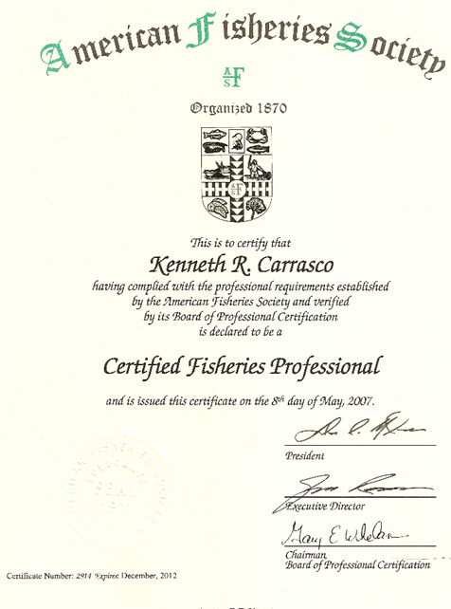
☞
Your name here !
☞
Remember your Certification number and expiration date!

Slide 27
Any further questions?
Please contact:
Mary Webb Banning
Educational Program Coordinator,
mbanning@fisheries.org
  (301) 897 - 8616, ext. 204
Lauren Maza
Director of Student & Professional Development,
lmaza@fisheries.org
  (301) 897 - 8616, ext. 225

