Slide 1
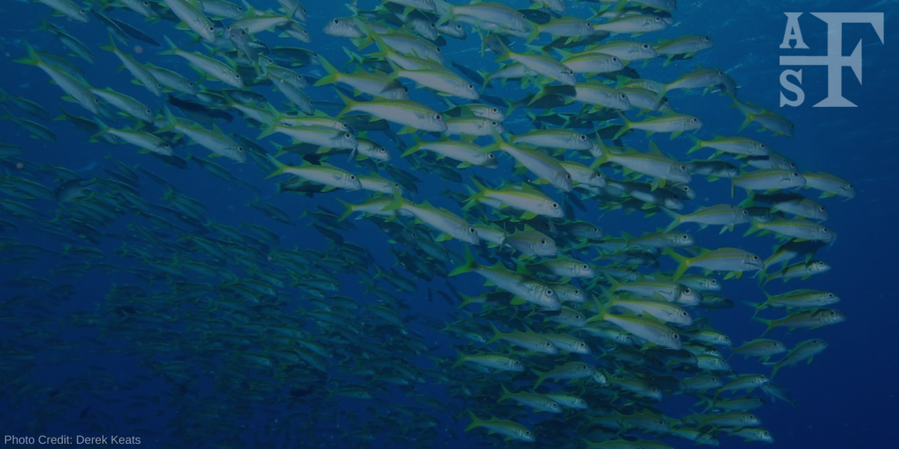
The American Fisheries Society
2020 Winter/Spring Chapter Meetings
Notes:
Greetings from your AFS Officers and the AFS headquarters office in Bethesda, Maryland! We thank you for giving us a few minutes to say hello during your unit meeting and to provide you with and update on AFS and our many activities. Thank you also for being a member of your chapter, and we hope you enjoy your time at your chapter’s meeting!

Slide 2
AFS celebrates its 150th year in 2020!
Learn more about the commemorations through AFS social media and on our 150th site:
https://150years.fisheries.org/
Notes:
This year marks the 150th anniversary of AFS! We’ll be celebrating this milestone all year long with special programming at the annual meeting, features in Fisheries, and on the website.

Slide 3
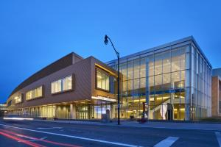
2020 Annual Meeting
August 30 – September 3, 2020
Columbus, Ohio
Abstract deadline: March 20, 2020
Photo credits: experienceColumbus.com
Notes:
The 2020 Annual Meeting will be held August 30-September 3. AFS hopes to see you in Columbus, Ohio! Don’t miss your opportunity to submit your research for presentation during the meeting - this year’s abstract deadline is March 20, 2020. Many chapters will be participating in the Annual Meeting by bringing an exhibit to Columbus to help commemorate the 150th Anniversary. If your unit is interested in participating, visit https://150years.fisheries.org/. You can also submit stories and photos to help celebrate this event!

Slide 4
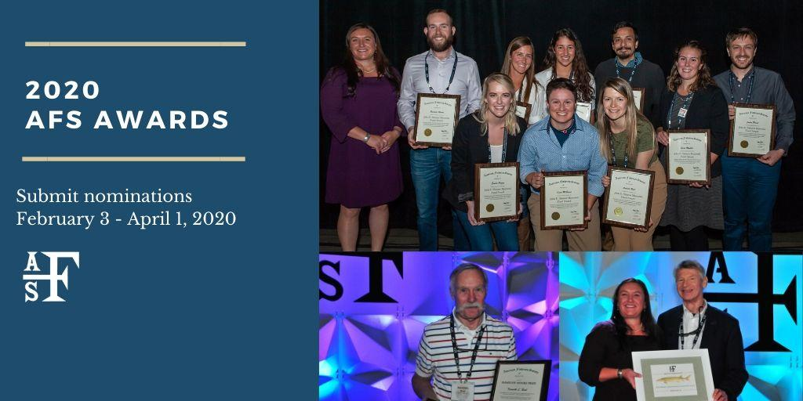
2020 AFS Call for Awards
Recognize your colleagues for their contributions with the AFS Awards Program!
Nominations due date: April 1, 2020
Notes:
Do you have a colleague who deserves recognition for work in fisheries? The 2020 Call for Awards is coming February 3-March 16! Over 20 awards will be presented in Columbus, which recognize fisheries professionals at all levels of their careers, plus AFS chapters and volunteers. Learn more about the award categories on the AFS website.

Slide 5
Contribute to a Fisheries Legacy
Actions today, will impact tomorrow.
Members and non-members are eligible to join the 1870 Society.
This society is designed to recognize generosity and philanthropy in our community, and help sustain the activities, initiatives, and programs of AFS.
Benefits available to donors!
Notes:
Whether you’re a member or non-member, if you’re passionate about fisheries we encourage you to consider joining the 1870 Society. This is a donor club that recognizes annual contributions to AFS, as well as planned and legacy gifts (including wills, bequests, and other contributions).

Slide 6
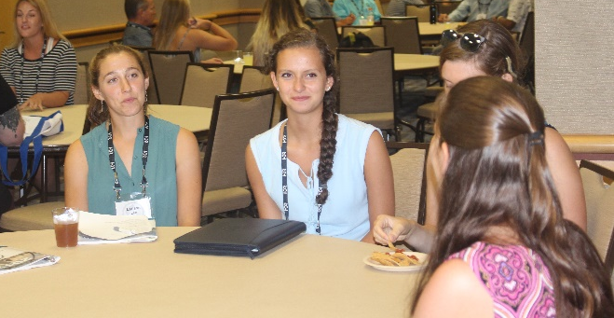
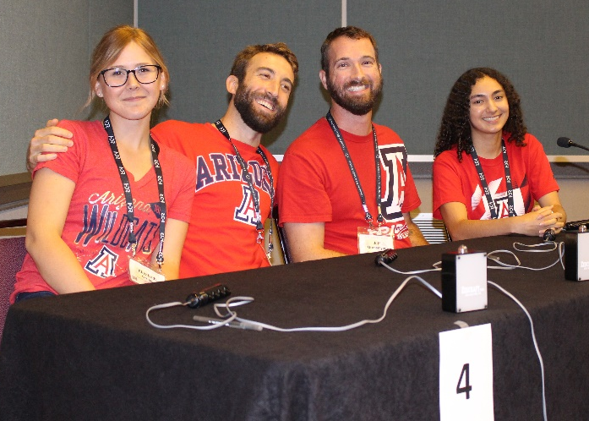
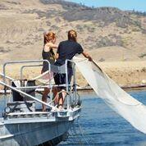
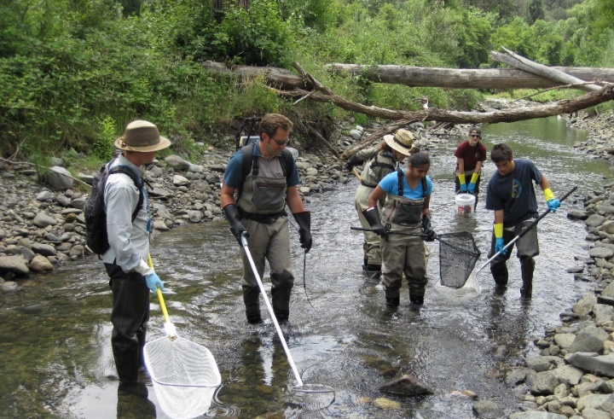
AFS Members
Give Back to Fisheries
Join a committee and help guide the direction of AFS and the profession
Serve as a mentor to students and early career professionals
Apply to mentor high school students through the Hutton Program
Become a journal reviewer or editor
Notes:
AFS is an organization dependent upon volunteers for continuity and to set the course of the organization! As a new member, we know that it can seem intimidating to become involved as a new member. Suggestions for becoming involved towards the beginning of your membership with AFS include joining a committee or mentoring a student at a local or national event. Your commitment ensures the future of the Society, the profession, and the quality of aquatic resources for future generations.

Slide 7
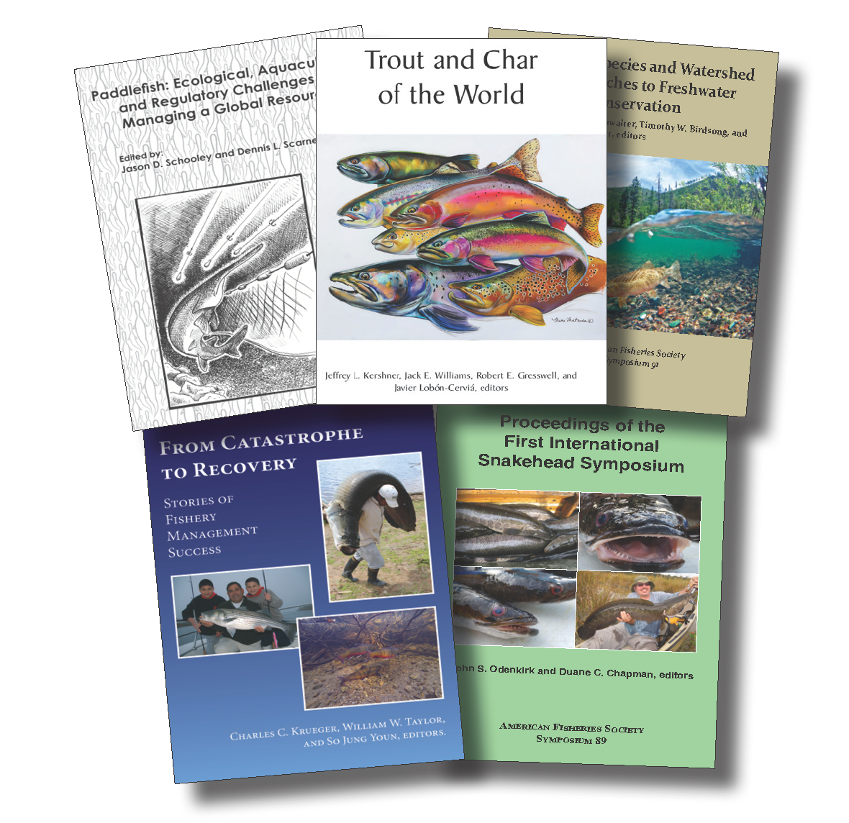
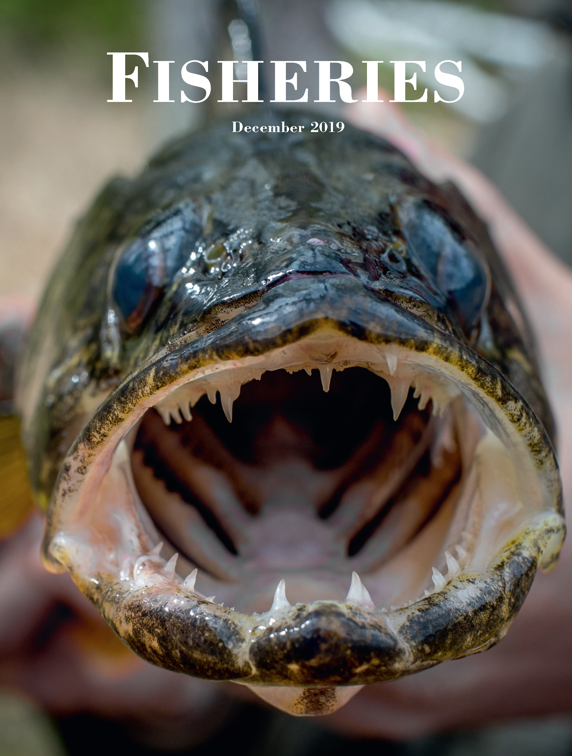
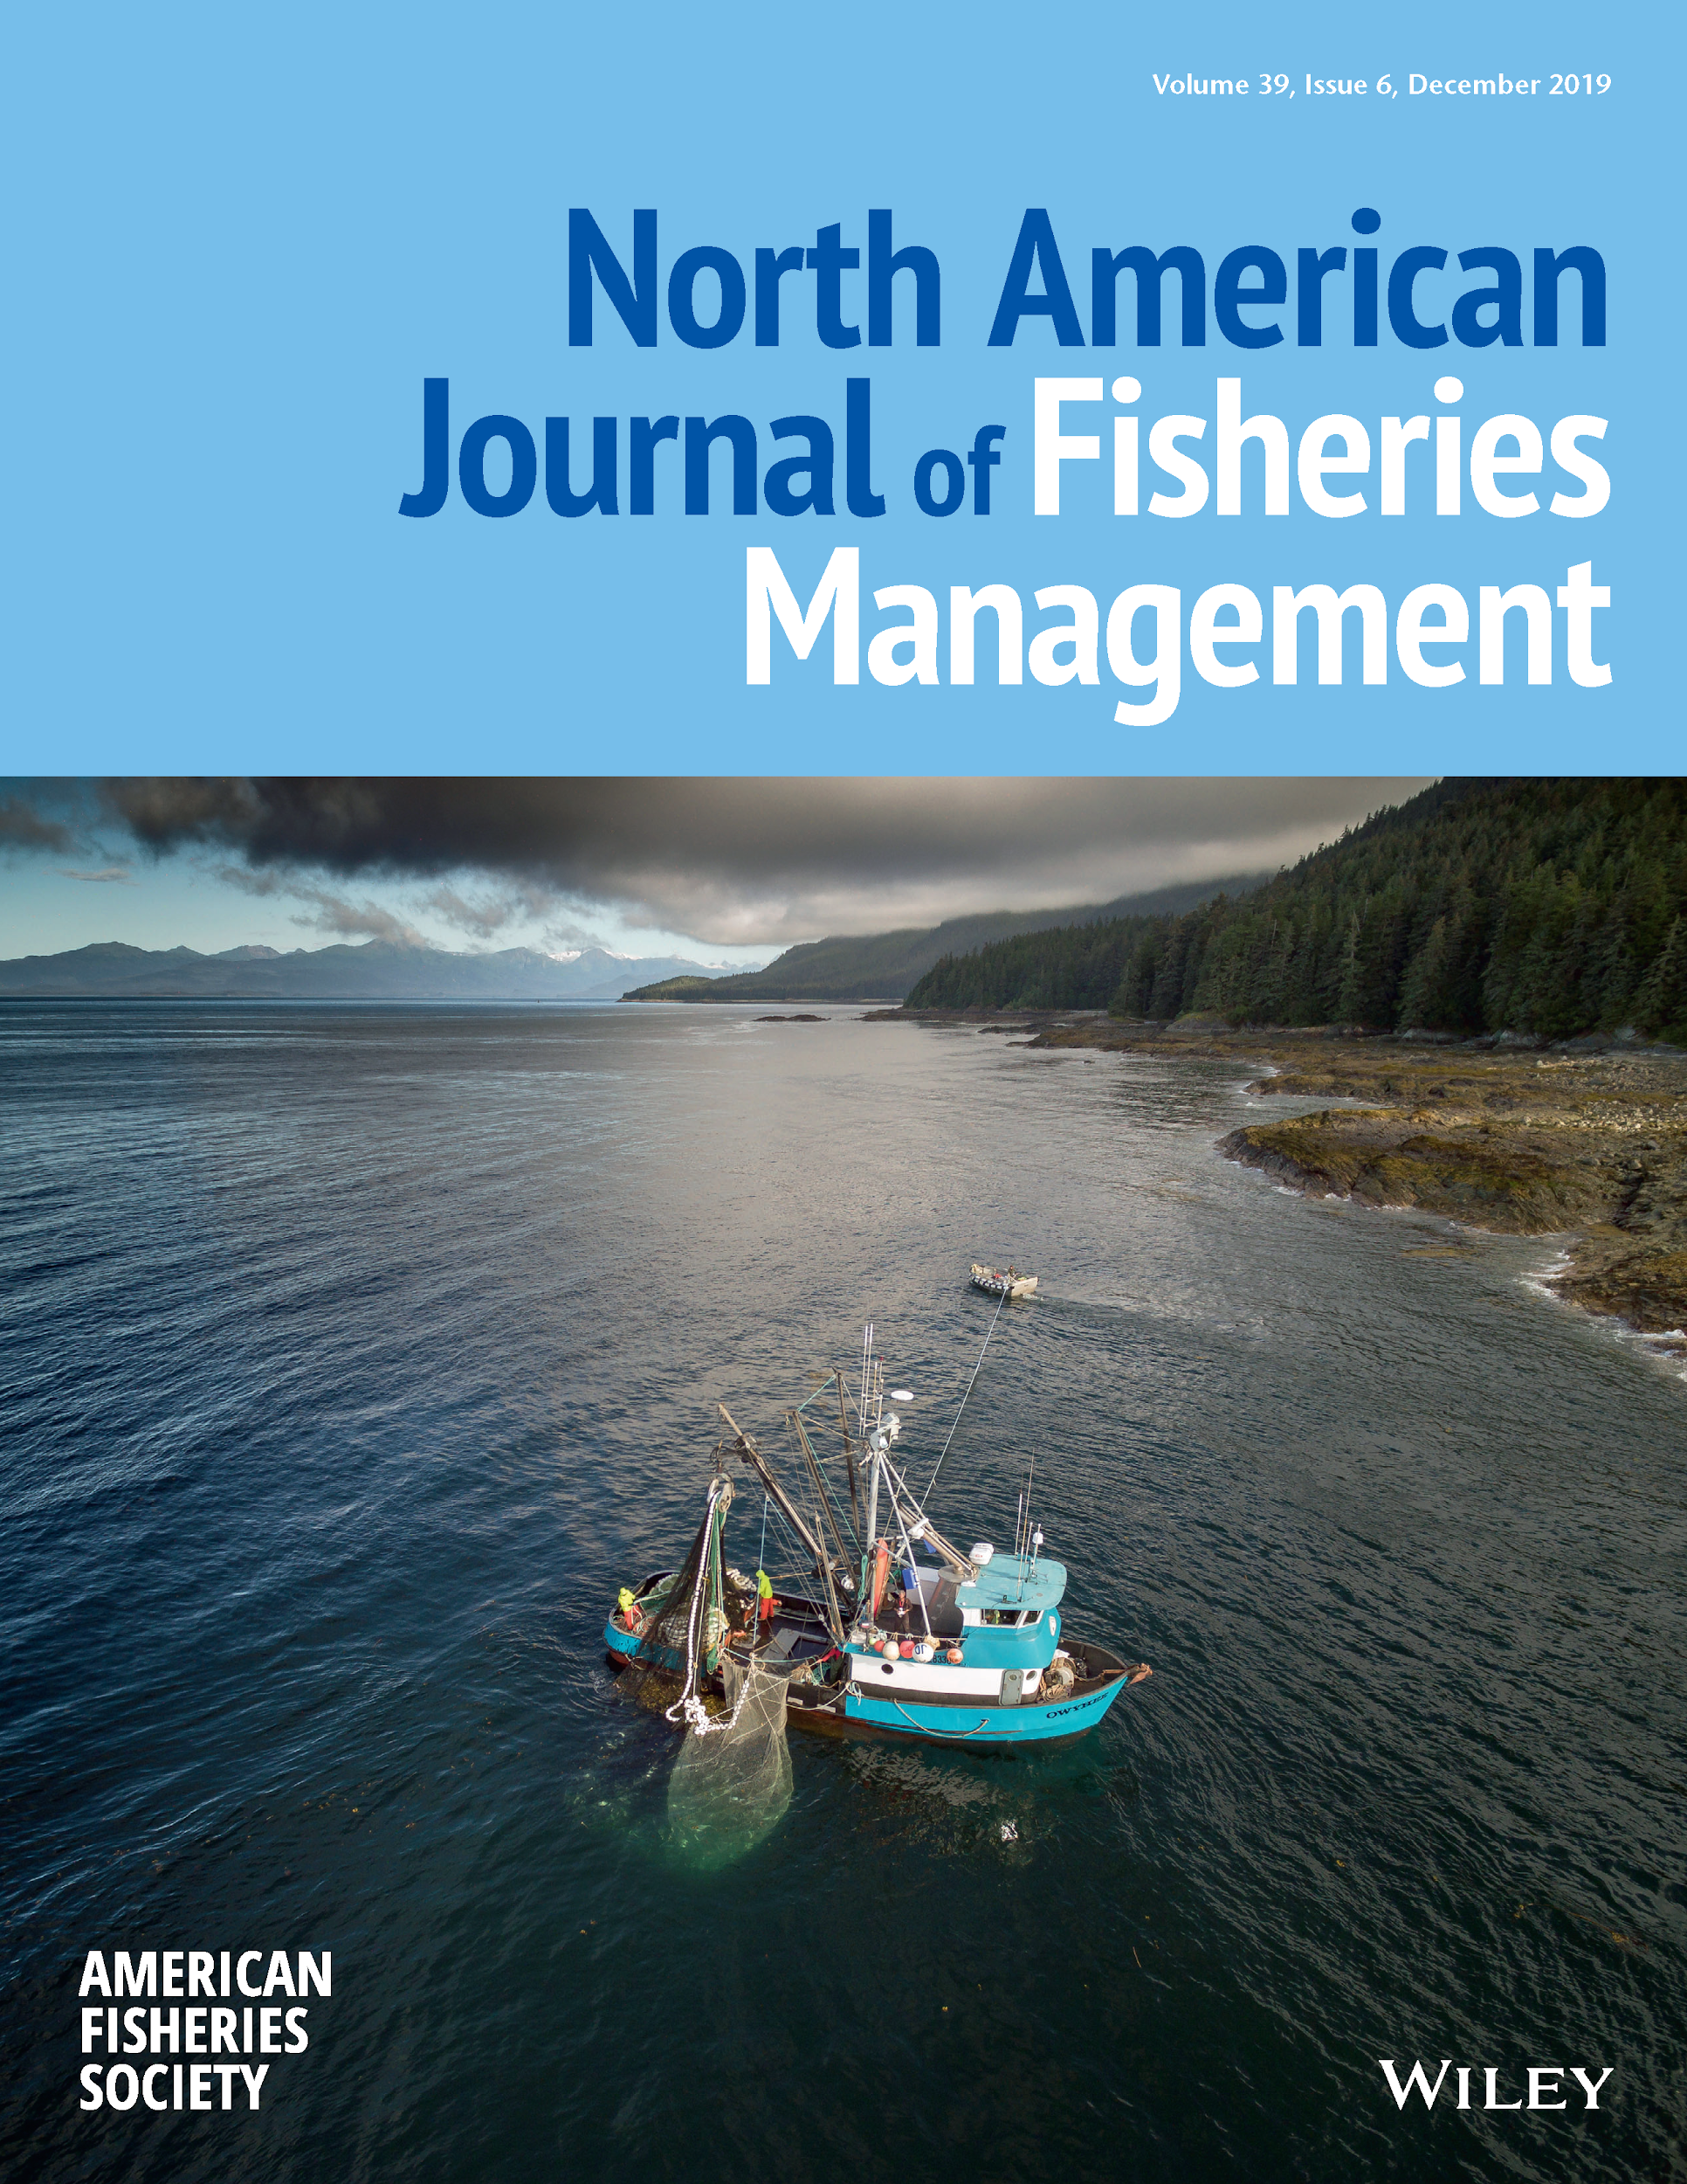
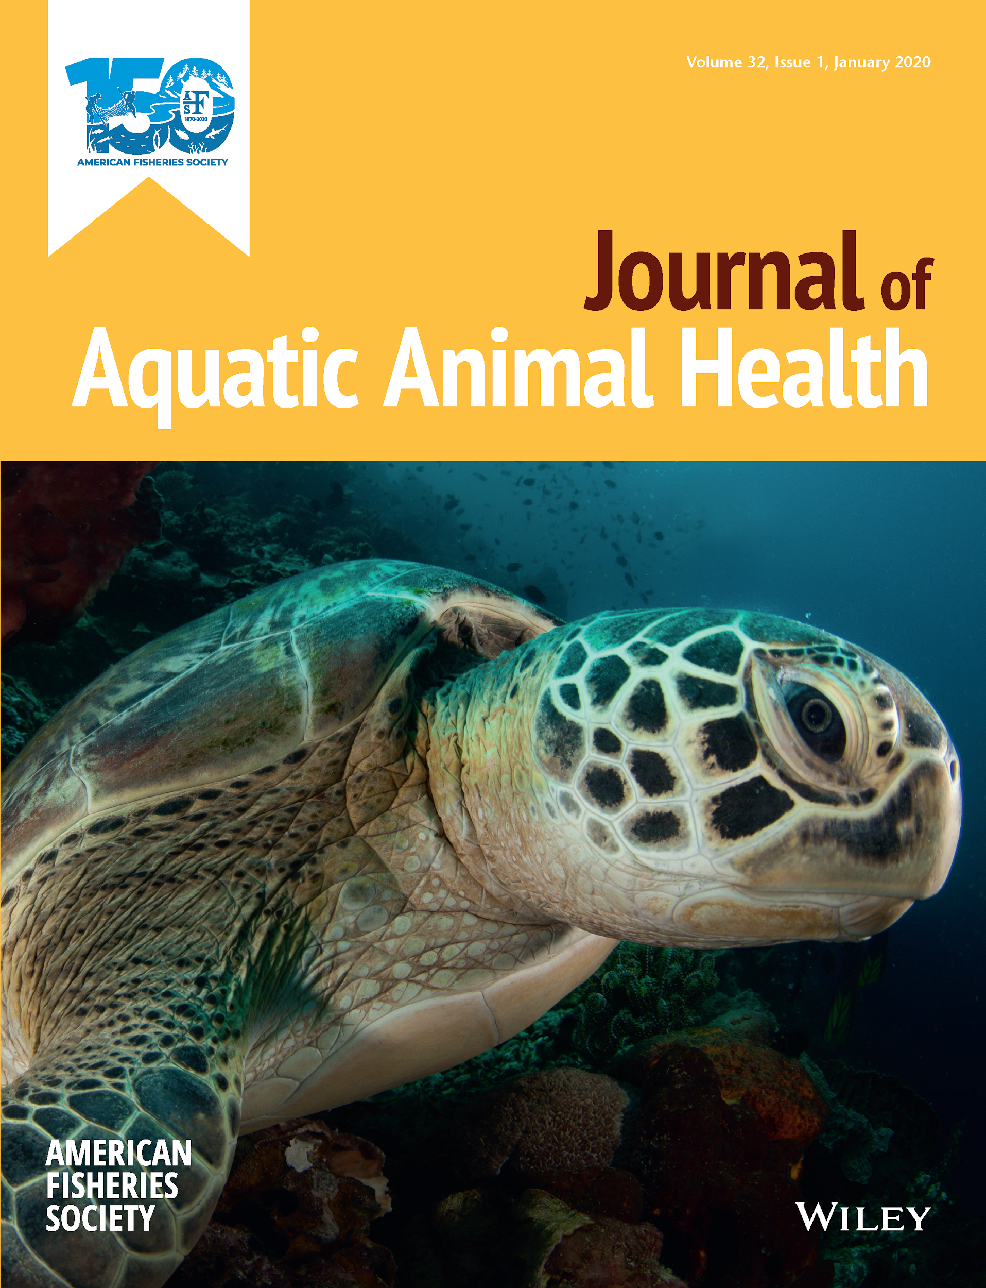
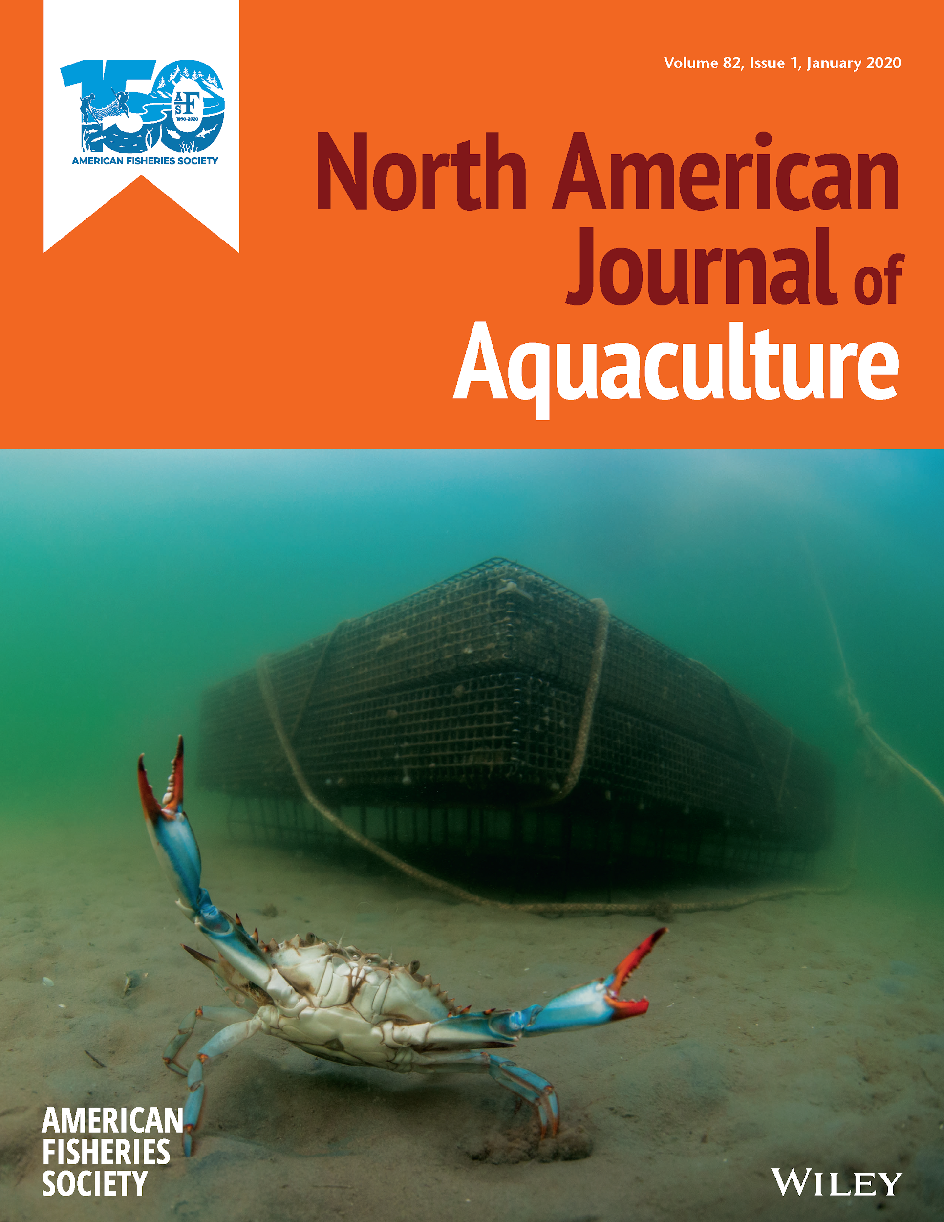
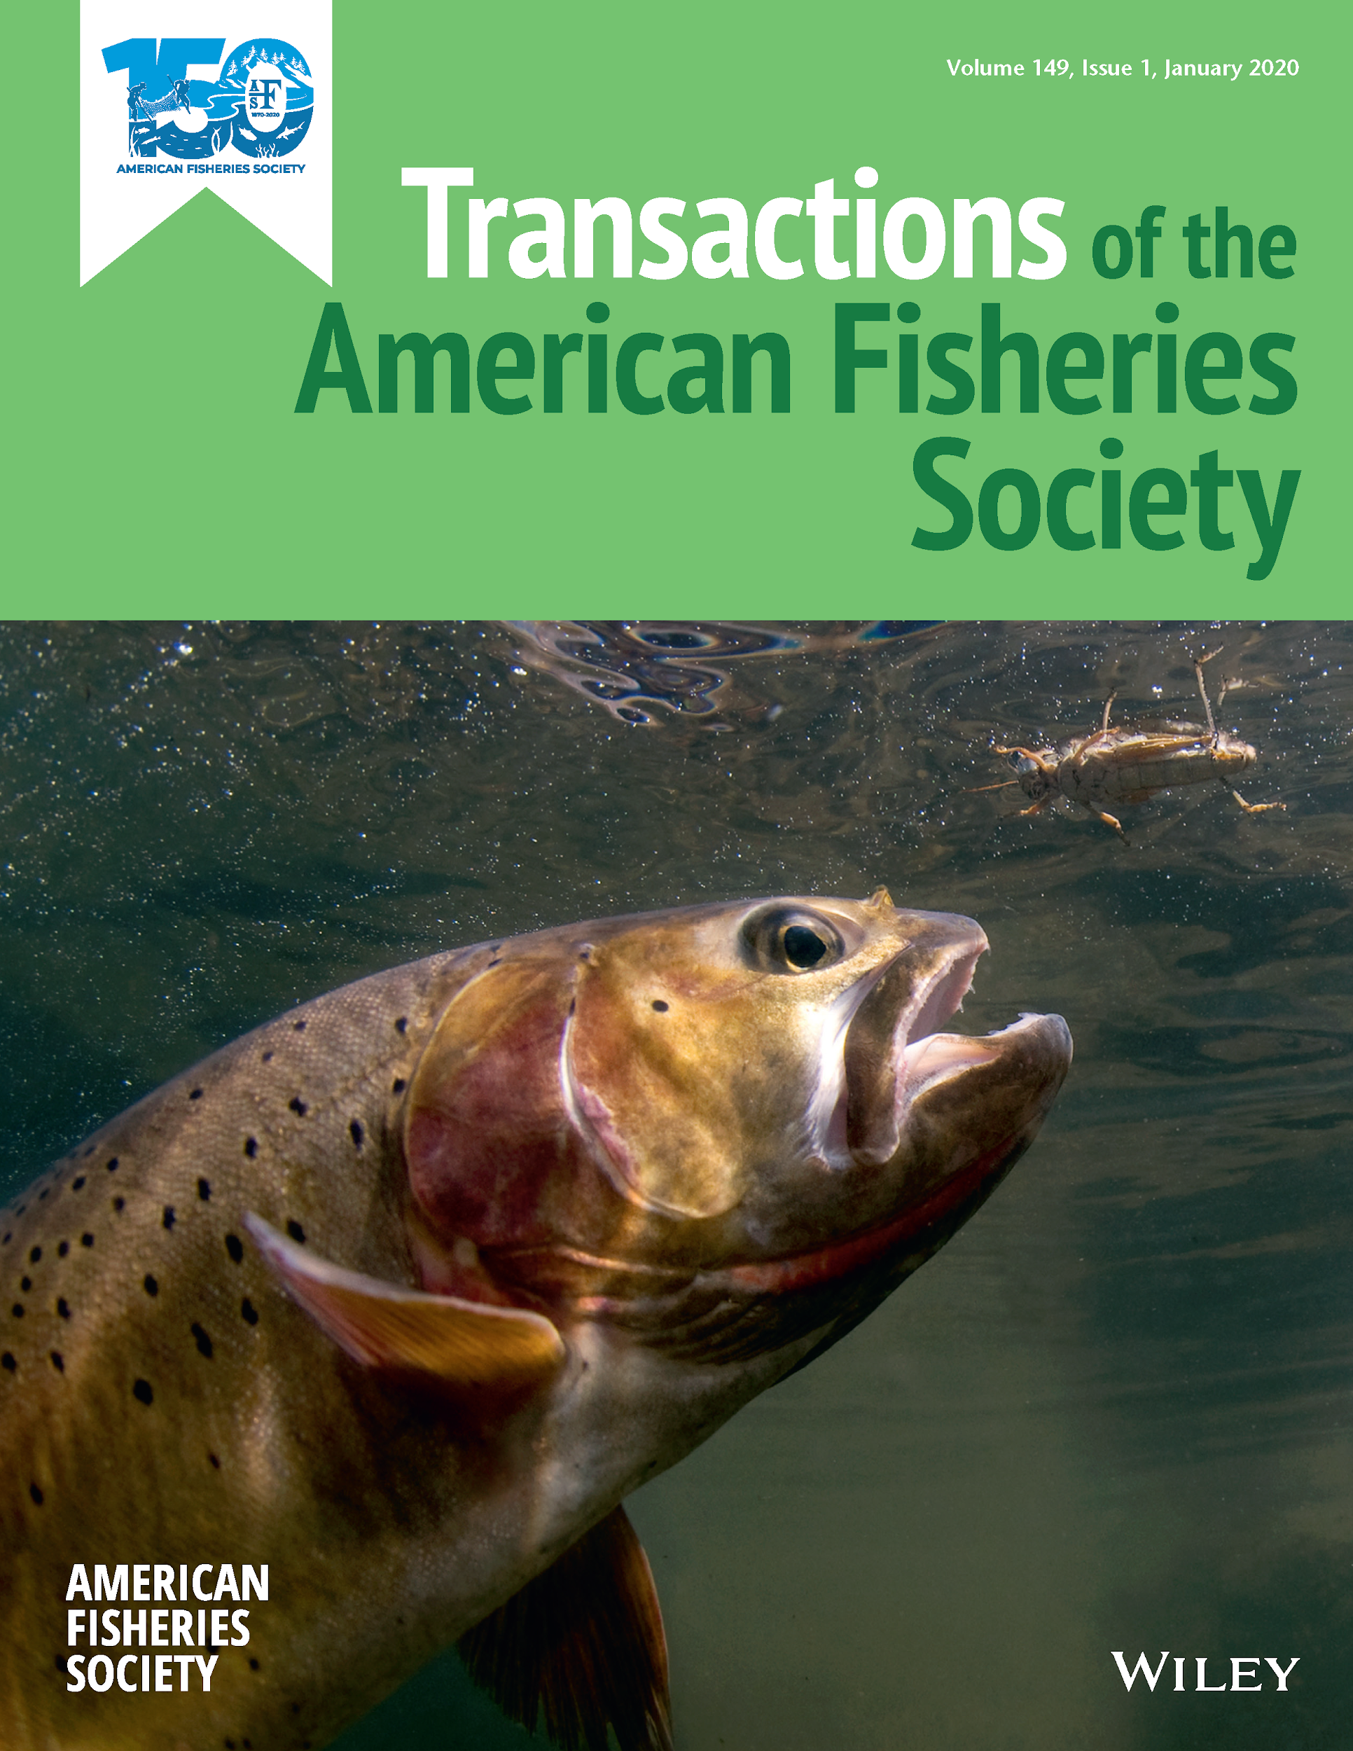
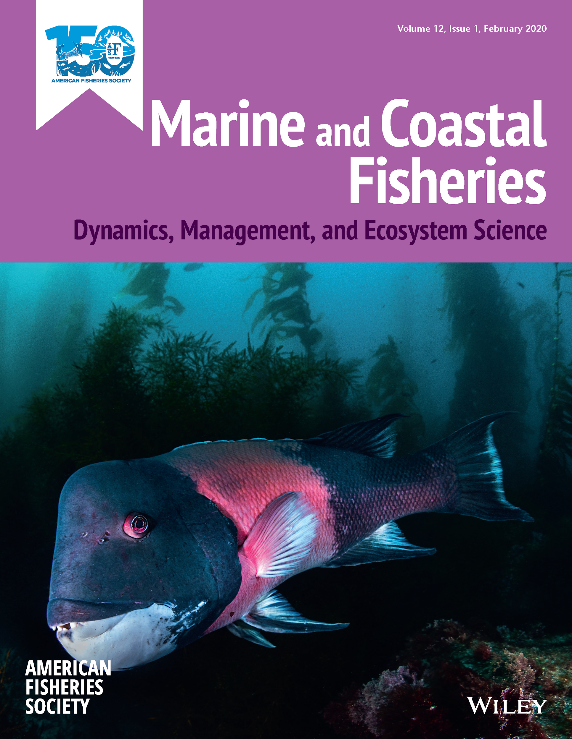
AFS Member Benefits
Journals and Publications Benefits:
Free online and mobile app access to AFS publications about the latest science
Discounts on books in the AFS bookstore, with 7 new titles in 2019, including Trout and Char of the World
Notes:
Your AFS membership grants you access to the latest published science. Recent and upcoming special sections include authors writing on captive propagation of imperiled species in the North American Journal of Aquaculture, integrated pest management in the North American Journal of Fisheries Management, and telemetry networks in the northwest Atlantic and Caribbean in Marine and Coastal Fisheries.

Slide 8
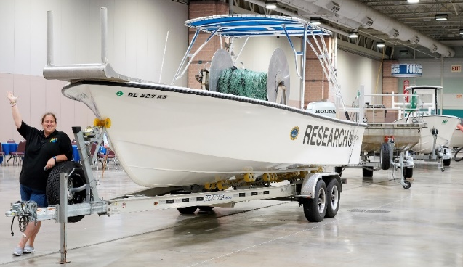
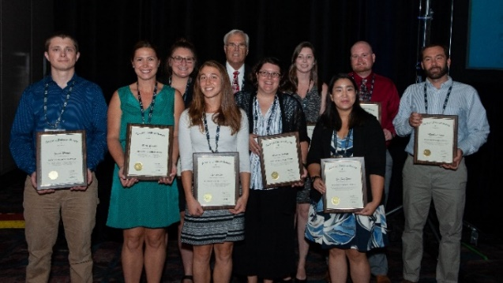
AFS Member Benefits
Discounted registration fees to the Annual Meeting for AFS Members
Opportunities for AFS travel grants
Attend Continuing Education Courses at reduced registration rates
Join AFS online for educational webinars
Notes:
Speaking of discounts, AFS members enjoy a reduced registration fee for the national Annual Meeting. The Meeting features the latest science presented as abstracts during symposia, as well as plenary sessions. In addition, attendees can participate in networking events to catch up with colleagues and potentially meet collaborators for future projects! Some members qualify to apply for grants to help offset travel costs to the Annual Meeting!

Slide 9
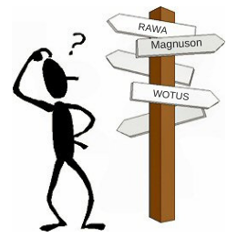
Concerned about Washington?
AFS policy staff keep track of the latest federal legislative and regulatory actions impacting fish, work to influence policy, and keep the membership informed and engaged!
Supported funding for USGS Cooperative Fish & Wildlife Units
Engaged membership in support of Recovering America’s Wildlife Act
Worked with partners to oppose roll-backs to Clean Water Rule
Vngaged membership in support of Recovering America’s Wildlife Act
Development of updated climate policy and outreach strategy for 2020
Notes:
You know that you should keep track of policy and legislation related to aquatic conservation - these issues matter and have an impact upon your ability to do your job - but sometimes work and life get in the way. As a member benefit, AFS is engaged in fisheries policy on behalf of fisheries professionals on critical topics such as support for the USGS Cooperative Fish and Wildlife Units, the Recovering America’s Wildlife Act, the Waters of the U.S. Rule, and climate science and the impacts of climate change on fisheries resources.
AFS has dedicated policy staff to direct our engagement, but we rely on member volunteers to help develop and disseminate policy recommendations and advocate for fisheries management and conservation using best science available.

Slide 10
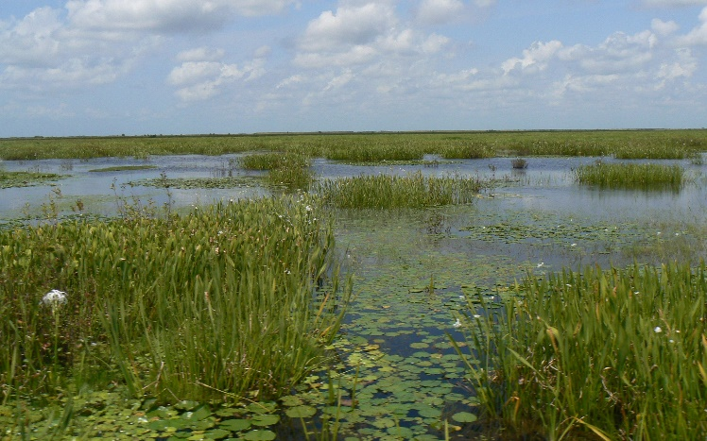
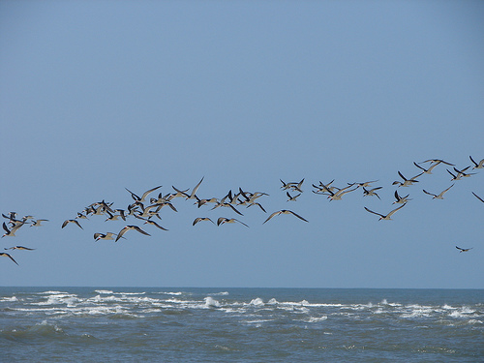
AFS Supports Funding for
Fisheries Research
Support for funding for USGS Cooperative Fish & Wildlife Units
Notes:
As just one example, AFS has actively supported robust funding for the USGS Cooperative Fish and Wildlife Units after the Trump Administration sought to eliminate all 40 units in 38 states. To do this, AFS met with USGS Director Jim Reilly, The Office of Management and Budget, and sent letters to Congress stressing the importance of the units to fisheries professionals and urging them to support funding for critical program vacancies. For FY2020, the coop units will get a $5.6M increase over the 2019 to $18.4M that will enable the units to fill 38 vacancies and establish up to four new units.

Slide 11
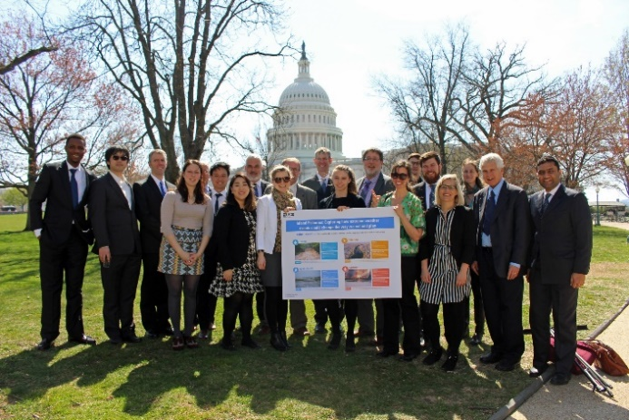
Want to get involved in policy?
Learn how to get your chapter more involved in supporting policy initiatives
Publicize policy news and opportunities on your chapter’s social media
Share your expertise to help inform AFS climate policy\
To get involved, contact AFS Policy Director Drue Winters at dwinters@fisheriesoirg

Slide 12
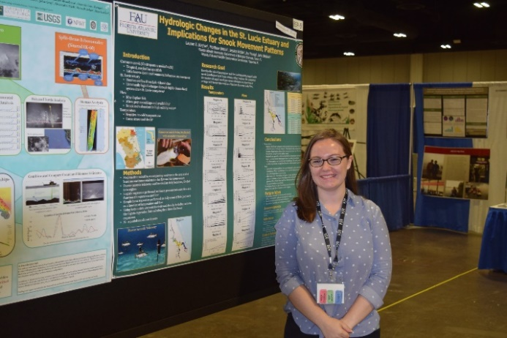
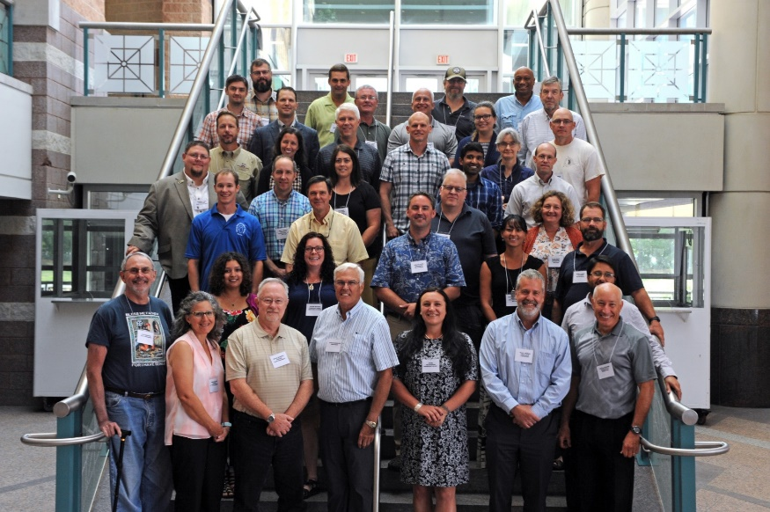
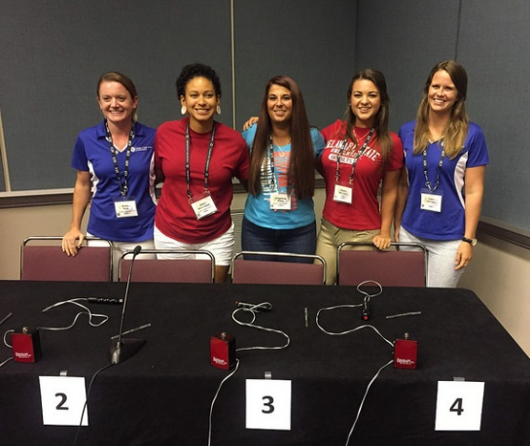
Support fisheries science and conservation and grow as a professional
Join AFS
https://fisheries.org/membership/
membership@fisheries.org
301-897-8616
Notes:
If you’re looking to become more involved with fisheries, consider joining AFS if you haven’t already. While it is important to also support your AFS chapter by becoming a chapter member and being involved at that level, that is not AFS membership. To realize the many benefits described and to support critical AFS activities on science, professional development and fisheries conservation, you should join AFS in the membership category designed for you. You can find this at fisheries.org

Slide 13
Thank you!
Notes:
In closing, we thank you again for giving us a few minutes of your time today. Enjoy the rest of your time with your chapter!

