Slide 1
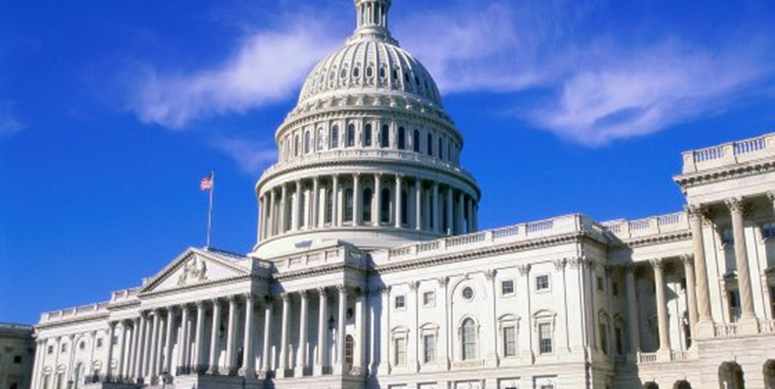
Support the recovering America’s wildlife act
Drue Winters, AFS Policy Director
dwinters@fisheries.org
301-897-8616 x202

Slide 2
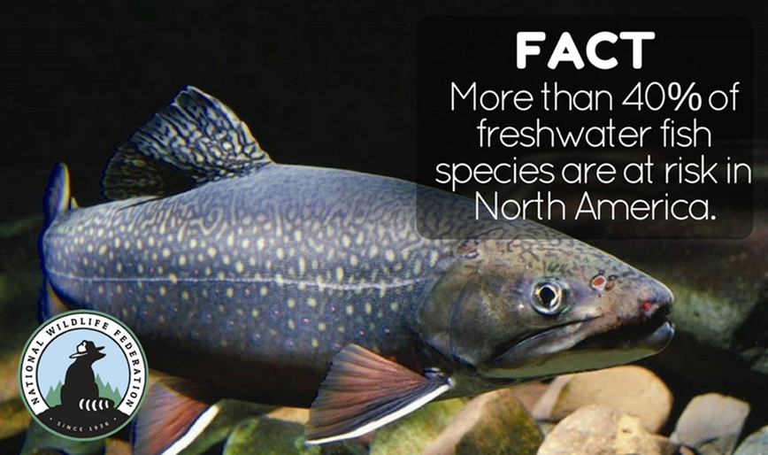
Recovering America’s Wildlife Act
Background on Recovering America’s Wildlife Act
Proactive conservation is critical for fish and wildlife
Benefits to natural resource professionals
Notes:
Blue Ribbon Panel on Sustaining America’s Diverse Fish and Wildlife came up with the idea of addressing the fish and wildlife crisis facing our nation through dedicated funding for proactive conservation.
Bi-partisan bill introduced in Congress in the House of Representatives in December (HR4647)
Sponsors: Rep. Jeff Fortenberry (R-Neb.) and Rep. Debbie Dingell (D-Mich.)
$1.3 billion annually to state fish and game agencies to fund proactive conservation of species of greatest conservation need in State Wildlife Action Plans
Funds come from on and offshore oil and gas revenues
Goal of keeping species out of the “emergency room” and off the Endangered Species List
America’s fish and wildlife are in crisis. Hundreds of species are at-risk of becoming threatened or endangered. In the last 100 years or so, more than 100 freshwater animal species have been recorded as extinct in North America. Hundreds of additional species of fishes, mollusks, crayfishes, and amphibians are considered imperiled. If models are correct, America's freshwater ecosystems are being depleted of species as rapidly as tropical forests. Research by the U.S. Geological Survey in 2012 concluded that since 1989, the number of extinct North American fish species has increased by 25% and up to another 86 species may disappear by 2050. With increasing temperatures and decreasing water flows, the crisis for aquatic species is even more acute.
More than 40% of aquatic species are in decline. The bill is good for fish AND good for the profession! More funding means more jobs in aquatic resource conservation.

Slide 3
AFS support is critical
Commit to support this effort
Establish Chapter Lead
Conduct outreach to build support in Congress
Connect with The Wildlife Society, National Wildlife Federation and State Agencies to educate about the need
Notes:
AFS has committed to supporting this effort. We’re partnering with conservation organizations like the NWF, TWS, AFWA and others to support it on Capitol Hill and at the grassroots level-that’s citizen led efforts to influence policy! We need your help!
Agree to support this effort and get a RAWA Chair in each chapter to organize outreach efforts and report back to AFS Policy Director with updates

Slide 4
recovering America’s wildlife act
Call members of House of Representatives in your state
Sign a letter of support
Use communications channels including social media to raise awareness
Send a letter to the editor of a newspaper in your area
In district meetings with members of Congress
Take a member of Congress of a field visit with TWS, NWF or state fish and wildlife agency
Notes:
*Action alerts
-Ask your chapter members to call members of Congress asking them to co-sponsor HR 4647. We’ll provide a script!
-Ask chapter member to send individual letters to their Representative via ournatureusa.com –ask them to co-sponsor the bill
*Have the chapter sign a letter of support:
https://www.nwf.org/-/media/Documents/PDFs/Wildlife-Conservation/NWF_Recovering-Americas-Wildlife-Act_2017_Sign-On-Letter.ashx?la=en&hash=4FBA73FA048664D3283D461036F0294EC78E53B7
*Social Media
Use your social networks (Facebook, Twitter, etc) to share, like and post/tweet items supporting these efforts. Hashtag #Funding4Wildlife
*Newsletter articles - you can reproduce ours or write your own with information about imperiled fish in your area.
*Develop quotes for news stories
* Submit Letters to the Editor to your local newspaper
* Conduct in-district meetings and field visits with members of Congress

Slide 5
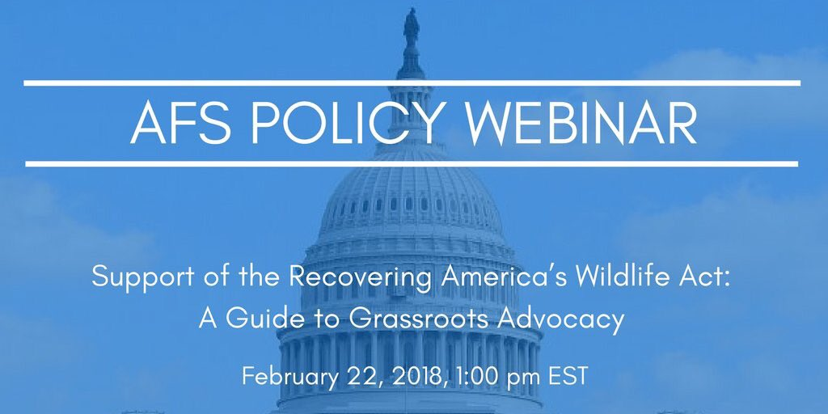
Learn more!
Notes:
Want to learn more about grassroots advocacy techniques? Join us for a free webinar on February 22 to learn how you can help AFS support the Recovering America’s Wildlife Act in your state. Participants will learn the fundamentals of a congressional “field visit”, the elements of a successful in-district meeting with a member of Congress, and how to prepare and deliver an “elevator speech” to spur a decision-maker into action! Led by AFS Policy Director, Drue Winters and joined by grassroots and field campaign experts from the conservation community, the webinar promises to enhance your professional skills portfolio through this “how to” designed specifically to support this important legislative effort.
Register here: https://fisheries.org/2018/01/support-of-the-recovering-americas-wildlife-act-a-guide-to-grassroots-advocacy/

