Slide 1
Chapter/Unit Tax Exempt Status & Reinstatement
Spring Webinar - April 22, 2020
Presenter: Dan Cassidy, AFS Deputy Director
Notes:
To change the image on this slide, select the picture and delete it. Then click the Pictures icon in the placeholder to insert your own image.

Slide 2
Agenda and Topics
Tax Exempt Status – What is it and how to maintain it?
Relationship with AFS (as the Group Exemption holder)
Exempt Status Reinstatement

Slide 4
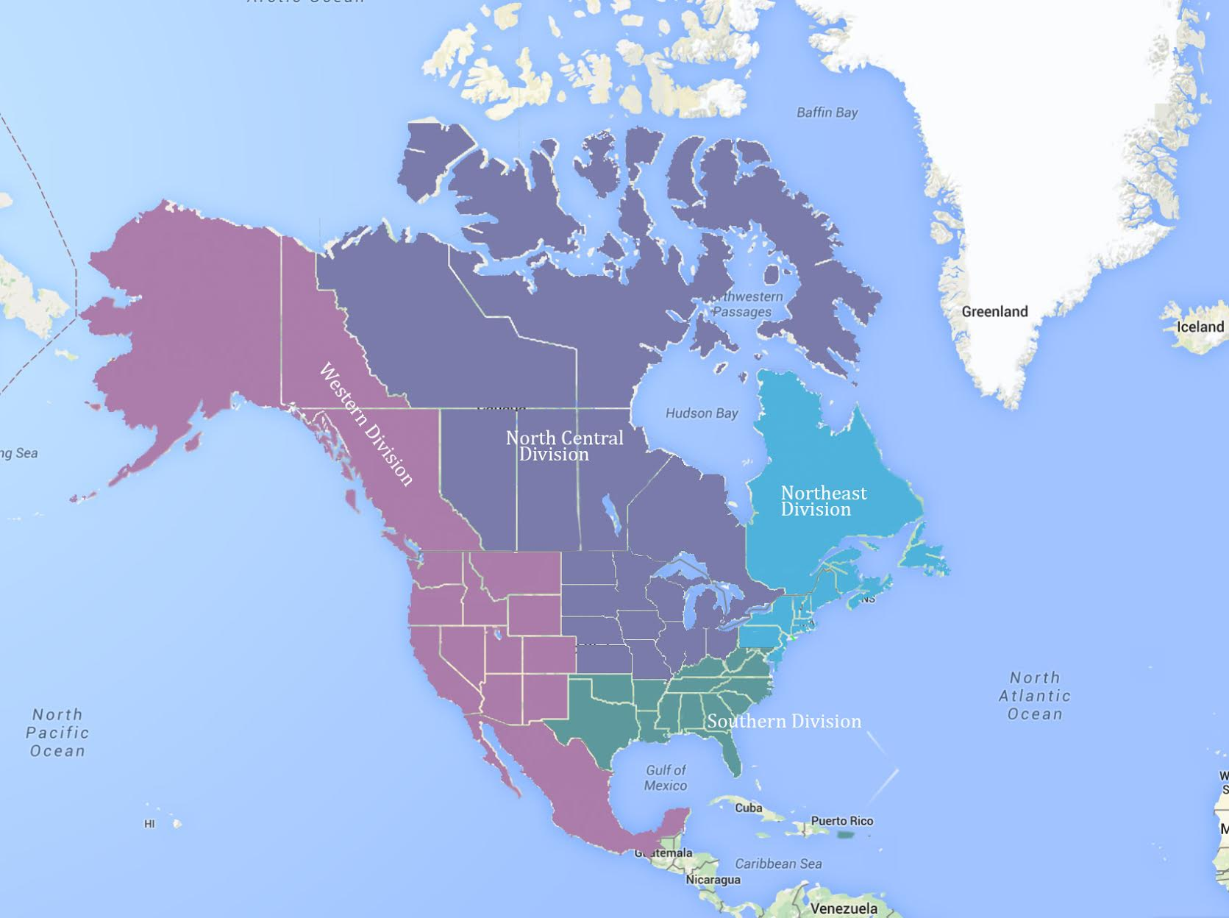
AFS Units
The Society is comprised of …
80+ Student sub-units
50 Chapters
22 Sections
4 Divisions

Slide 5
Background
AFS maintains and promotes unit resources and reminders through our website, Leaderline newsletter and Unit Leader sessions at our annual meeting.
Yet for many reason(s), these messages don’t always make it to Unit leaders

Slide 6
Background
Last year, AFS reviewed its Units’ tax filing compliance and realized quite a few had not filed IRS Form 990 (990, EZ, N) recently
or, last filed 3 or more years earlier
These later Units, effectively lost tax its exempts status under AFS group exemption since all but a few had applied for reinstatement

Slide 7
Background
Issue: To maintain tax-exemption in general and for eligibility under the AFS group tax exemption,
Units must file Form 990: Return of Organization Exempt from Income Tax” each year within four and one-half months after the close of their fiscal year (usually December 31). Organizations will be revoked by the IRS if they fail to file Form 990, 990ez or 990-N for three consecutive years and may lose their tax exemption if not retroactively reinstated (generally within 15 months).

Slide 8
Tax Exempt Status
To be tax-exempt under section 501(c)(3) of the Internal Revenue Code, an organization must be organized and operated exclusively for exempt purposes set forth in section 501(c)(3), and none of its earnings may insure to any private shareholder or individual.
Exempt purposes include:
charitable, religious, educational, scientific, literary, testing for public safety, fostering national or international amateur sports competition, and preventing cruelty to children or animals.
The term charitable includes advancement of education or science; and many others.

Slide 9
Did you know …
Most popular leagues that joined the 501(c)(6) group have given up their status. Most recently the NFL dropped its status in 2015, while Major League Baseball (MLB) relinquished its status in 2007. The National Basketball Association (NBA) was never tax-exempt.
In 2016, the PGA Tour reported over $1.2 billion in revenue in its 990 form, its version of a tax return. For comparison, in 2015 (its last year exempt), the NFL league office reported $82 million.

Slide 10
Other Groups that are Tax Exempt

Slide 11
Tax Exempt Status
Non-profit status may make an organization eligible for certain benefits, such as state sales, property, and income tax exemptions; however, this corporate status does not automatically grant exemption from federal income tax.
To be tax exempt, most organizations must apply for recognition of exemption from the Internal Revenue Service to obtain a ruling or determination letter recognizing tax exemption.
Generally, tax exemption from federal income tax on most sources of income such as dues, registrations, sponsorships, exhibits, investments, publication sales, etc (except for advertising)

Slide 12
Tax Exempt Status
Even though an organization is recognized as tax exempt, it still may be liable for tax on its unrelated business income.
Unrelated business income (UBI) is income from a trade or business, regularly carried on, that is not substantially related to the charitable, educational, or other purpose that is the basis of the organization's exemption.
Organization’s may still be subject to other state and local taxes such as personal property, sales tax and excise taxes

Slide 13
Tax Exempt Status
Maintaining tax exempt status is equally as important as receiving a determination letter or operating under a group tax exemption holder (AFS)
To maintain tax exemption, organizations must file Form 990, 990ez or 990-N each year
Avoid - private benefit, inurement, lobbying, political campaign activity, too much unrelated business income, not filing an annual 990 tax information form, and failing to achieve its original purpose
Exempt organizations are required to file annual returns. If an organization does not file a required return or files late, the IRS may assess penalties.
If an organization does not file as required for 3 consecutive years, it automatically loses its tax-exempt status.

Slide 14
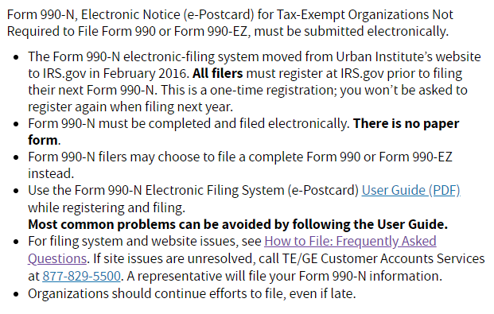
Tax Forms
← Form 990 or 990ez
Form 990-N →

Slide 15
Group Exemptions
What is a group exemption letter? The IRS sometimes recognizes a group of organizations as tax-exempt if they are affiliated with a central organization. This avoids the need for each of the organizations to apply for exemption individually. A group exemption letter has the same effect as an individual exemption letter except that it applies to more than one organization.
What is the reason for group exemptions? Group exemptions are an administrative convenience for both the IRS and organizations with many affiliated organizations. Subordinates in a group exemption do not have to file, and the IRS does not have to process, separate applications for exemption. Consequently, subordinates do not receive individual exemption letters.

Slide 16
Group Exemptions
What types of organizations can qualify for group exemptions? Exempt organizations that have, or plan to have, related organizations that are very similar to each other may apply for a group exemption.
What are central and subordinate organizations? Groups of organizations with group exemption letters have a “head” or main organization, referred to as a central organization. The central organization generally supervises or controls many chapters, called subordinate organizations. The subordinate organizations typically have similar structures, purposes and activities.

Slide 17
Exempt Status Reinstatement
For AFS units that have lost its exemption status …
can apply for reinstatement
By submitting Form 1023 and required $ fee

Slide 18
Exempt Status Reinstatement
The good news is organizations can apply for reinstatement
The not so good news is there is an application form and filing fee
Chapters/units cannot secure reinstatement under AFS’s group exemption
The only way the unit/chapter can have its tax-exempt status reinstated is to re-apply for its own separate tax exemption
Because the 15-month window for retroactive reinstatement has passed

Slide 19
Exempt Status Reinstatement
The process of filing for exempt status as a 501(c)(3) organization will require the following:
Completion of the IRS Form 1023 (either long form or EZ where applicable) Application for Recognition of Exemption under Section 501(c)(3).
A filing fee to the US Treasury in the amount of $600 for applicant organizations using long Form 1023 or $275 if they qualify to use Form 1023EZ.
Completion of IRS Form 2848 (Power of Attorney) for those organizations that will use a third party to prepare their Form 1023 applications.
A federal Employer ID Number, which most already have.
A copy of the current Bylaws of the unit/chapter.
Attorney noted:
The unit/chapter’s conflict of interest policy, document retention policy and whistleblower policy.

Slide 20
Questions / Comments?
THANK YOU
for attending!!

