Slide 1
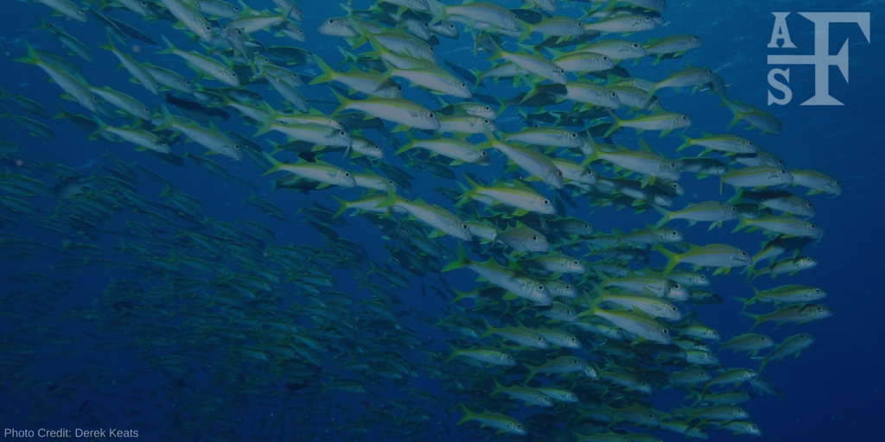
The American Fisheries Society
2019 Winter/Spring Chapter Meetings
Notes:
Greetings from your AFS Officers and the AFS headquarters office in Bethesda, Maryland! We thank you for giving us a few minutes to say hello during your unit meeting and to provide you with and update on AFS and our many activities. Thank you also for being a member of your chapter, and we hope you enjoy your time at your chapter’s meeting!

Slide 2
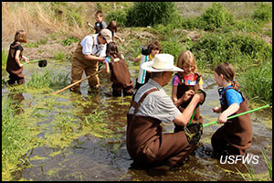
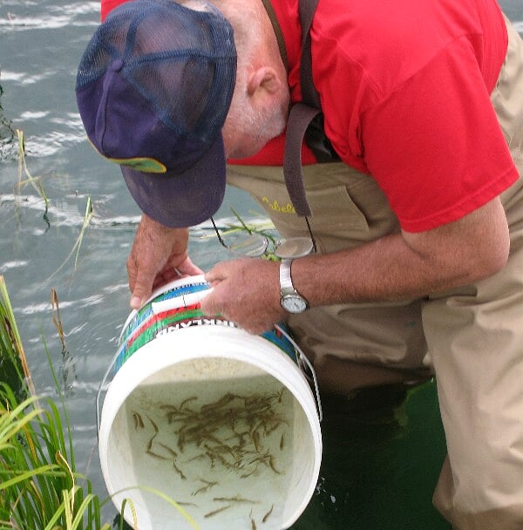
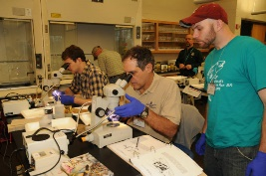
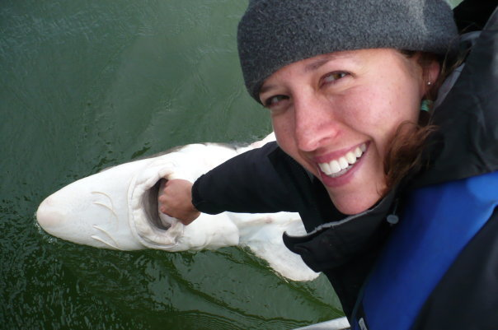
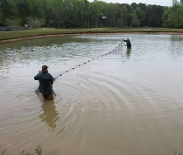
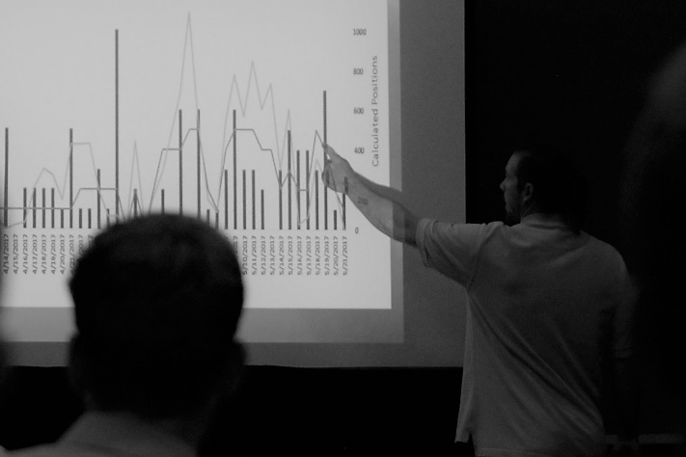
As a fisheries professional, you’re devoted to field, lab, and conservation work…
Notes:
As a fisheries professional, you spend your time dedicated to research and management in the field, lab, and in your agency’s offices. While you spend time every day thinking about species, populations, habitats and much more in freshwater or marine settings….

Slide 3

…but have you ever felt lost at sea professionally?
Notes:
...have you ever felt lost at sea as a professional?
Where can you go for the latest information related to your field? Who is out there advocating for professionalism? Where do you go to find information about jobs and training?

Slide 4
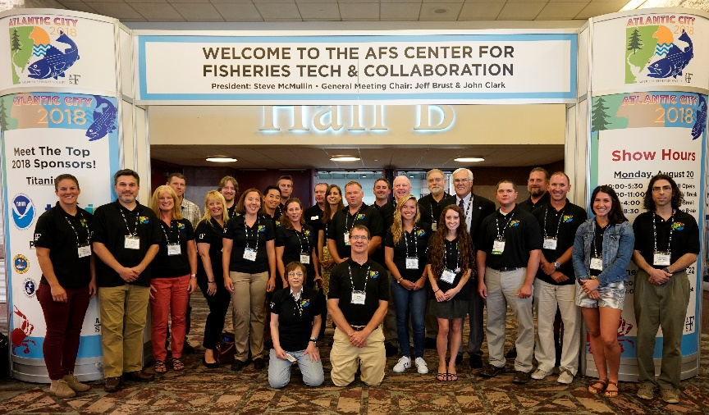
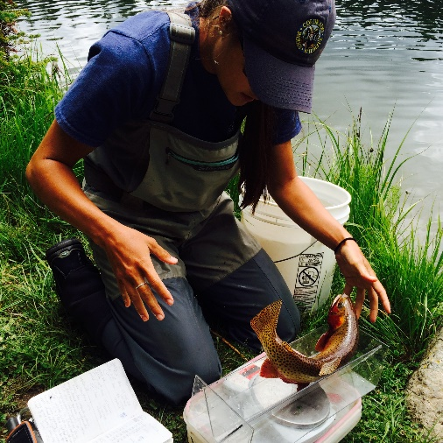
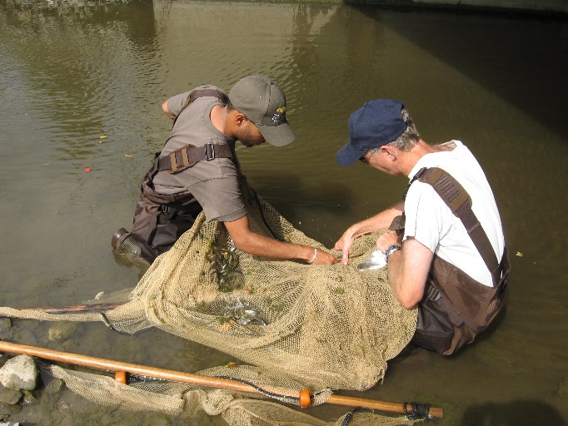
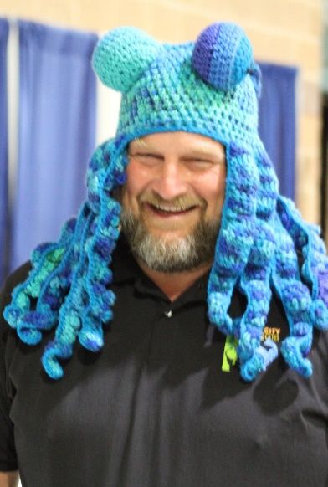
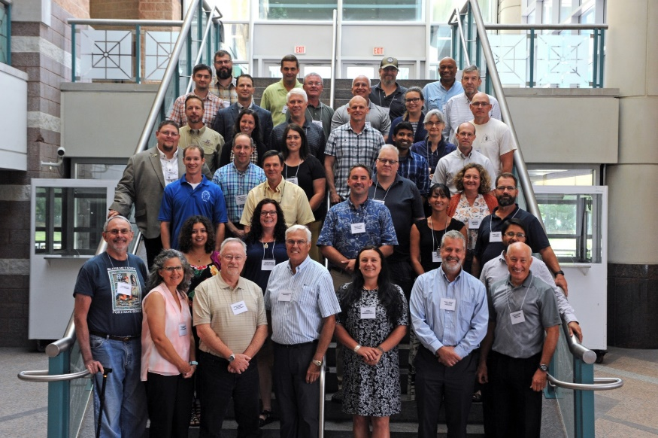
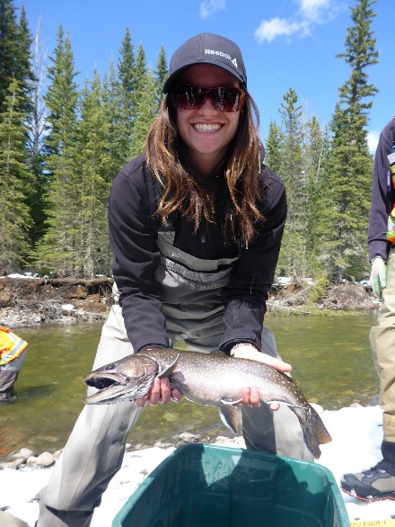
Make AFS your professional community for fisheries resources!
Notes:
We suggest that you think of making the American Fisheries Society more than just the chapter meeting you attend, which I would agree is important, but to think about AFS as your professional home!

Slide 5

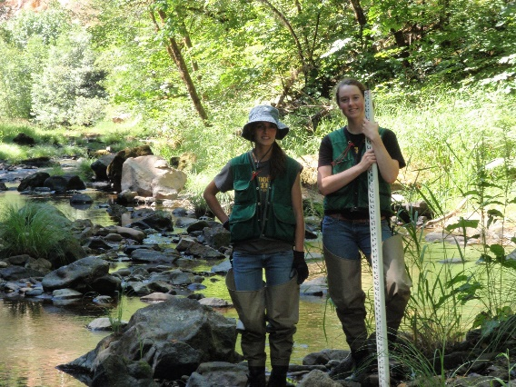
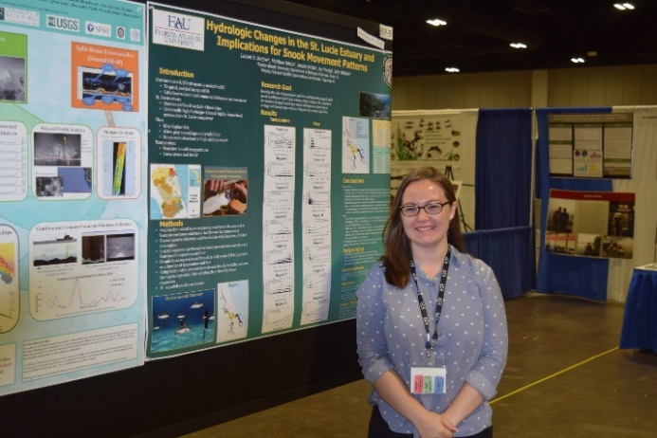

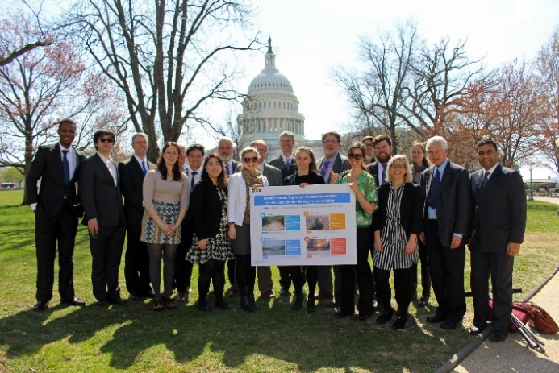
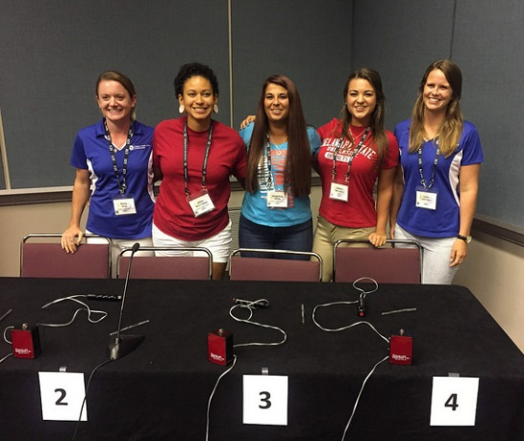
Did you know…
…there’s more to AFS than JUST Chapter Meetings?
Notes:
I hope that each of you recognize that there is much more to AFS than chapters! If you enjoy the benefits you receive from your local chapter, consider joining the American Fisheries Society at the national level! AFS is a national professional membership association for fisheries professionals, with a governing board and full-time staff working for the membership. You will be joining over 8000 members, primarily from the US and Canada, who work towards common goals of improving research, best practices, and sustainable management of fisheries resources.

Slide 6
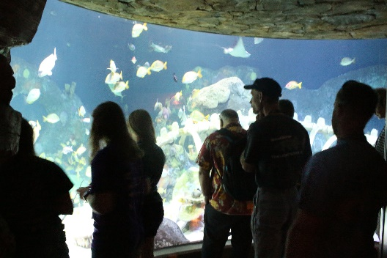
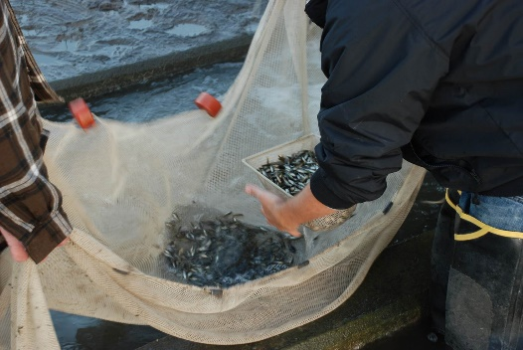
Getting to know AFS
AFS’s diverse membership represents the world’s leading experts in fisheries science, management and conservation
  AFS members have a range of backgrounds and expertise and include aquaculturists, biologists, ecologists, economists, engineers, fisheries managers, geneticists and social scientists.
  AFS members represent government agencies, commercial operations, academic institutions, research firms, student groups and media outlets.
Notes:
AFS members have a range of backgrounds and expertise and include aquaculturists, biologists, ecologists, economists, engineers, fisheries managers, geneticists and social scientists.
AFS members represent Federal and State government agencies, commercial operations, academic institutions, research firms, student groups and media outlets.
Sounds like an interesting group, you’re thinking, but what’s in it for me? What is included in my membership?

Slide 7
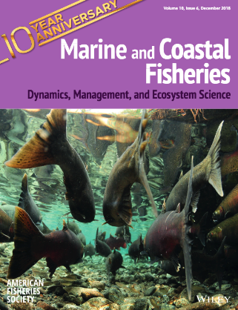
Maximize Your Membership!
Journals and Publications Benefits:
Free online access to five AFS journals, plus Fisheries Magazine
Page charge waivers are available for authors publishing in AFS journals
Discounts on books in the AFS bookstore

Slide 8

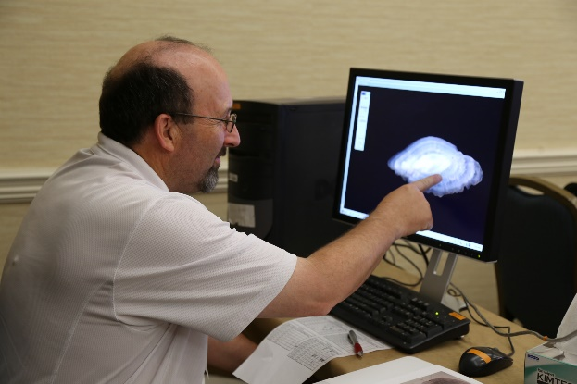
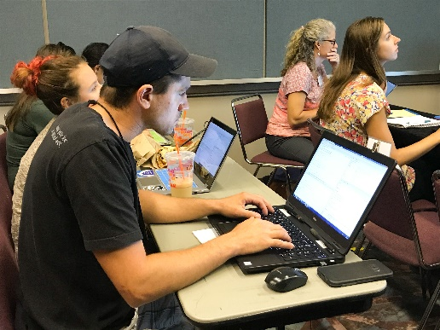
Maximize Your Membership!
Education Benefits:
Attend Continuing Education Courses at reduced registration rates
Join AFS online for educational webinars
Members can access webinar recordings on the AFS website
Notes:
You will also receive discounted registration for continuing education courses; recent courses have included GIS and Intro to R. In late 2017, AFS added a monthly webinar series to its education line up. Members may join sessions live and access webinar recordings via the Society’s website. By supporting AFS, you’re gaining support for your professional growth and productivity, which in turn helps your agency and the profession - talk about a win-win.

Slide 9

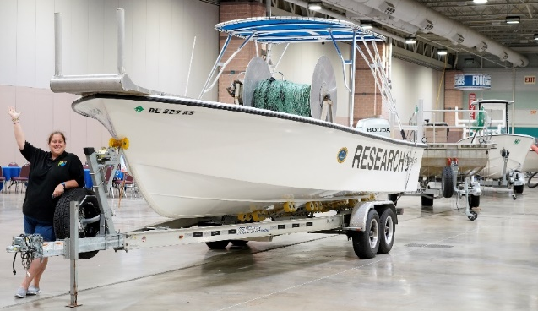
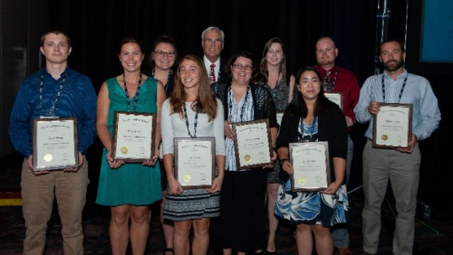
Maximize Your Membership!
Annual Meeting Benefits:
Discounted registration fees to the Annual Meeting for AFS Members
Opportunities for AFS travel grants for meetings and conferences
Networking opportunities onsite – open to all attendees and some specifically for students
Notes:
Speaking of discounts, AFS members enjoy a reduced registration fee for the national Annual Meeting. The Meeting features the latest science presented as abstracts during symposia, as well as plenary sessions. In addition, attendees can participate in networking events to catch up with colleagues and potentially meet collaborators for future projects! Some members qualify to apply for grants to help offset travel costs to the Annual Meeting!

Slide 10

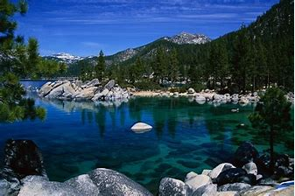
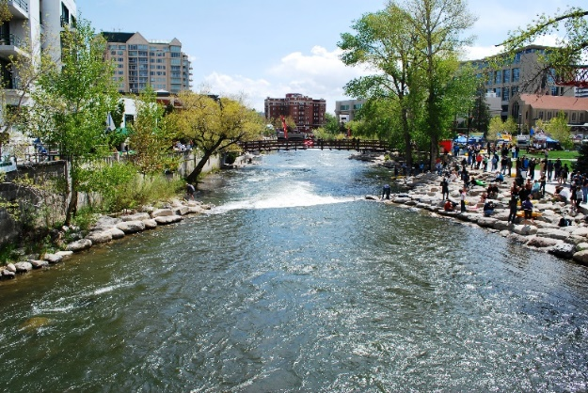
2019 Annual Meeting
Join the American Fisheries Society and The Wildlife Society this year, as we come together for a joint national conference
The event will likely be the largest ever gathering of fish and wildlife professionals!
September 29 – October 3, 2019
Reno-Tahoe, Nevada
Notes:
In 2019, we’re doing things a little differently for the Annual Meeting. AFS will be joining with The Wildlife Society for a joint meeting in Reno, Nevada. This momentous event will likely be the largest gathering to date of wildlife and fisheries biologist and managers! We hope to see you September! Of course, we recognize that attending the Society’s annual meeting may not be possible for many of you due to travel constraints but there is much more about AFS that is beneficial even if you can’t attend in person.

Slide 11


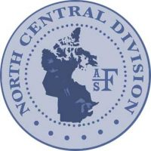


Meet Professionals with Similar Interests
AFS Units provide more opportunities to connect with colleagues!
  4 Geographic Divisions
  55 Chapters across North America
  84 Student Subunits at colleges & universities
  20+ Sections focused on specialized interests
Notes:
Since AFS is made of a community of fisheries professionals, your membership presents opportunities within the Society to meet fish folk with similar interests. You already know about your local chapter, but there are also four geographic divisions within AFS, all of which host some sort of annual meeting within their region and often these are easier to attend than the national meeting. Furthermore, if you have an interest in say, Fish Health, Genetics, Fish Culture, or any one of 23 different subject areas you can join an AFS section that focuses on those special interests. You are free to join as many sections as you’d like!

Slide 12
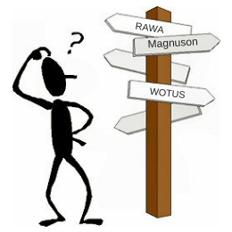
Concerned about Washington?
You know you should keep track of legislation that will impact fisheries, but how do you know where to start?
AFS policy staff keep track of the latest in Congress and keep the membership informed and engaged
Supported funding for USGS Cooperative Fish & Wildlife Units
Significant effort to support Recovering America’s Wildlife Act
Worked with partners to oppose roll-backs to Clean Water Rule
Notes:
You know that you should keep track of policy and legislation related to aquatic conservation - these issues matter and have an impact upon your ability to do your job - but sometimes work and life get in the way. As another member benefit, AFS helps support government programs on behalf of fisheries professionals. Sometimes AFS is one a few voices, if not the only voice, which is advocating for fisheries science and management.

Slide 13


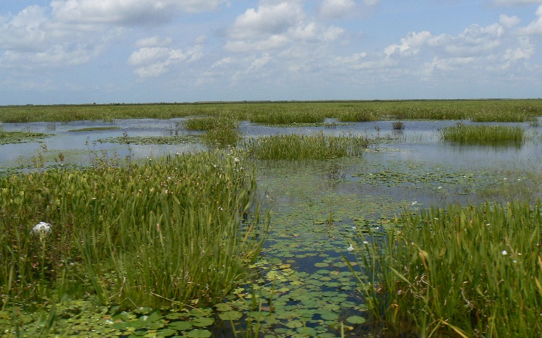
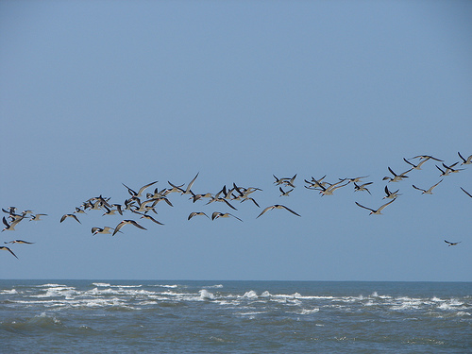
AFS Supports Conservation Policy
Support for funding for USGS Cooperative Fish & Wildlife Units
Notes:
For example, AFS has actively supported robust funding for the USGS Cooperative Fish and Wildlife Units after the Trump Administration sought to eliminate all 40 units in 38 states. To do this, AFS met with USGS Director Jim Reilly, The Office of Management and Budget, and sent letters to Congress stressing the importance of the units to fisheries professionals and urging them to support funding for critical program vacancies.

Slide 14
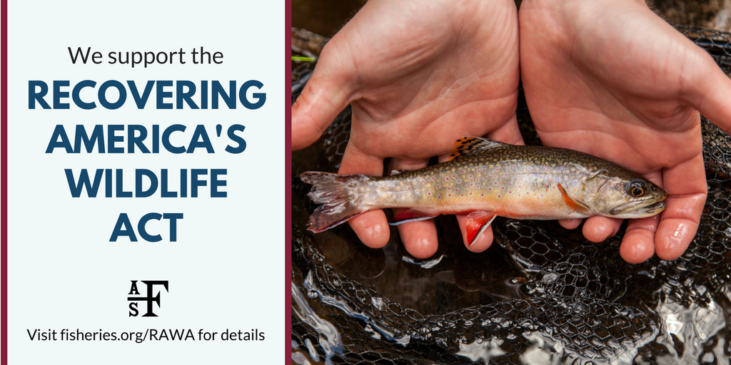
AFS Supports Conservation Policy
Support for Recovering America’s Wildlife Act
Notes:
AFS directed significant time and effort in support of the Recovering America’s Wildlife Act, a bill that calls for dedicated funding for state agencies to conduct proactive fish and wildlife conservation. AFS efforts to support this bill included holding dozens of meetings on Capitol Hill, releasing a new report with The National Wildlife Federation and The Wildlife Society on the wildlife crisis, and conducting an educational Capitol Hill briefing on the report.

Slide 15
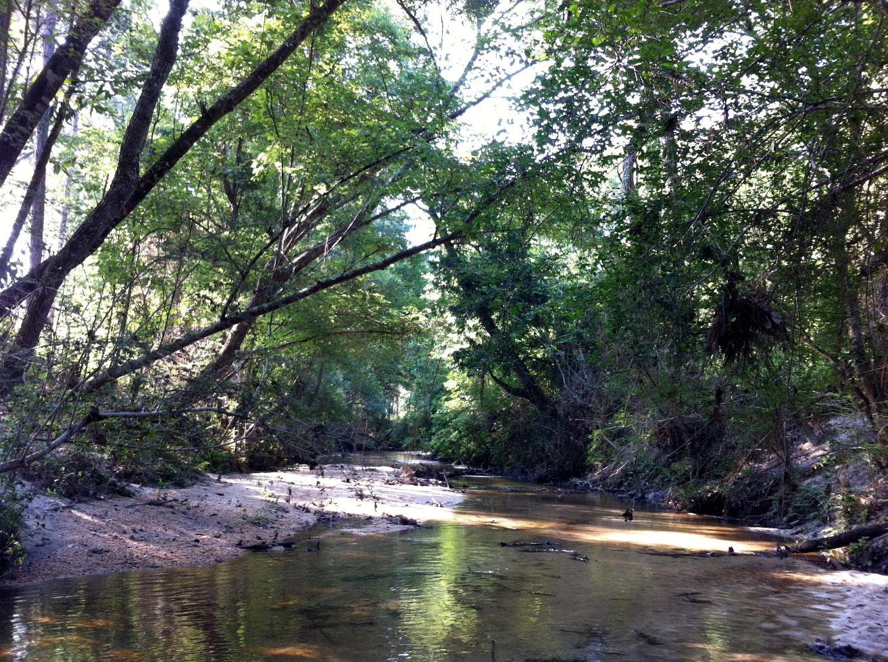
AFS Supports Conservation Policy
Opposition to roll-backs to the Clean Water Rule
Notes:
AFS worked closely with conservation partners in opposition to proposed roll-backs of the Clean Water Rule. Actions included developing an important synthesis paper on the value of Headwater Streams, submitting regulatory comments and helping to educate members and the public about the importance of federal protection of small streams and wetlands for fish and wildlife.
It’s also important to note that AFS leadership frequently meets with and informs state and federal agency directors on the importance of fisheries professionalism, training, and support. The point here is that, without AFS, an important voice would be missing.

Slide 16
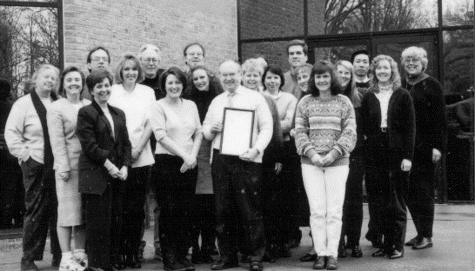
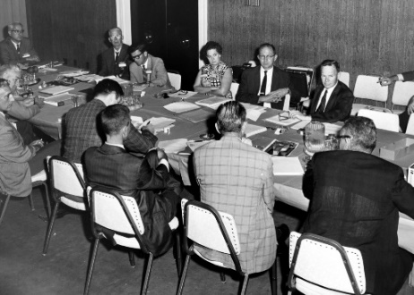
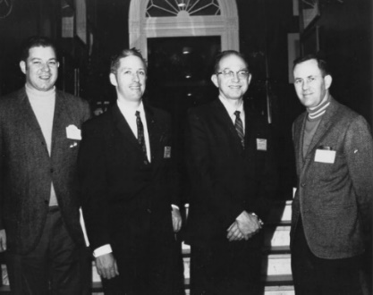
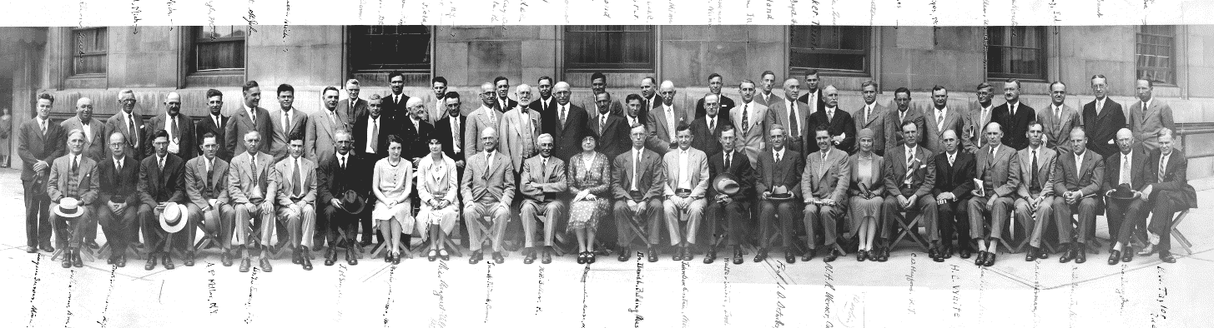
AFS – Past, Present, and Future
AFS members are a part of a long legacy of Fisheries Professionals!
AFS will be celebrating its 150th Anniversary in 2020.
What do the next 150 years hold for the fisheries profession? The future is uncertain – we need your help in shaping the future of fisheries!
AFS Staff 1999
AFS Executive Committee,
Annual Meeting 1968–1969
Northeastern Division Officers 1969-1970
60th AFS Annual Meeting, Toronto, 1930
Notes:
By joining AFS, you’re joining a long history of practitioners in fisheries and a legacy of members working in freshwater and marine conservation. The Society was started by fisheries biologists, for fisheries biologists and has continued addressing the common needs of all within the profession to the present day. AFS will be celebrating its 150th anniversary in 2020, with a year of commemorations that kick off at the Reno-Tahoe meeting. We’re proud of this history spanning a century and a half, and we need your help and commitment to ensure the future of fisheries for the next 150 years! The future is uncertain, and we urge you to join with the organization that is as concerned about the future of your profession as you are.

Slide 17
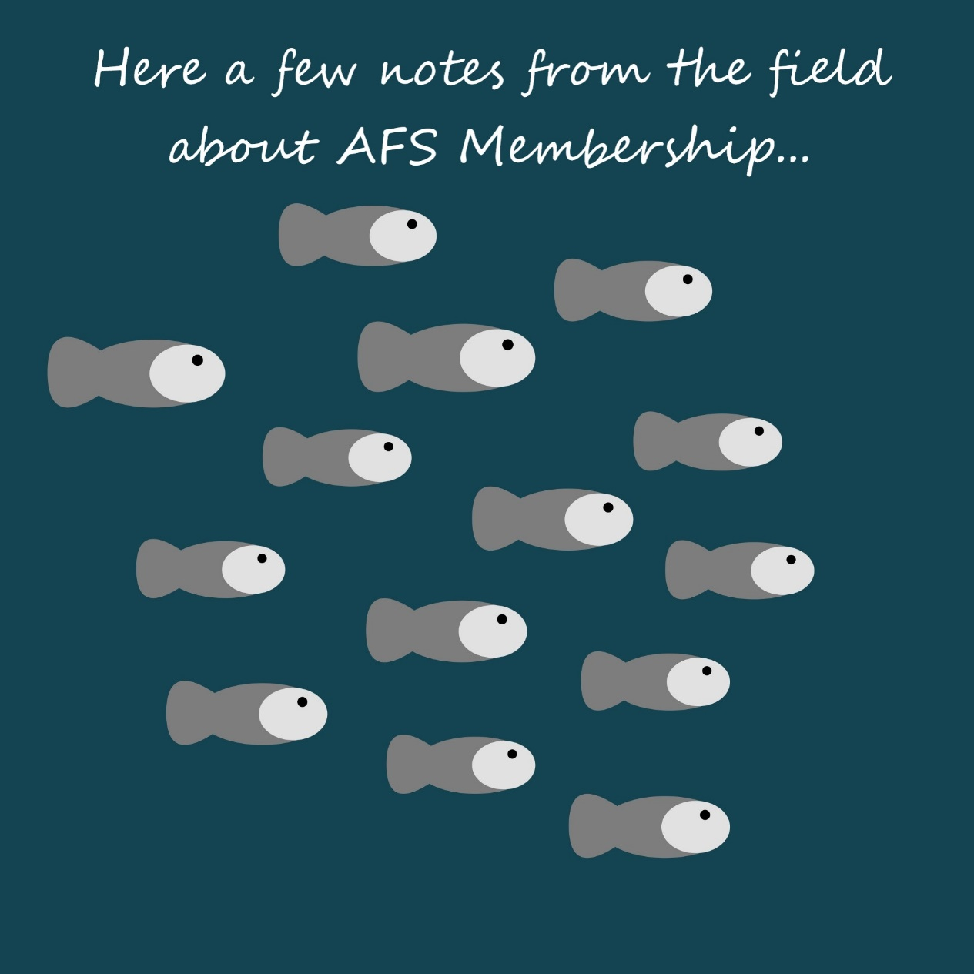
Not convinced?
There’s no need to take our word for it!
Notes:
Wait, you’re still not convinced? There’s no need to take our word for it. Here are a few comments from members!

Slide 18
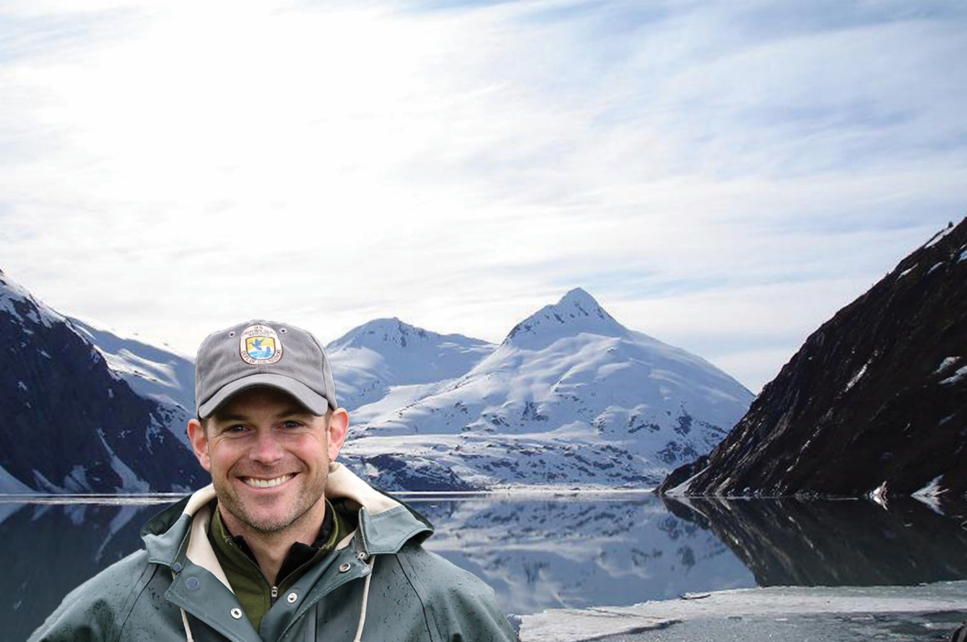
AFS Fan Mail…
“My Alaska Chapter requires full AFS membership because we saw the clear benefits. We can simply do more…with more resources.”
-Aaron Martin
FWS
Anchorage, AK
Notes:
From Aaron Martin, with the Fish and Wildlife Service in Anchorage, Alaska: “My Alaska Chapter requires full AFS membership because we saw the clear benefits. We can simply do more…with more resources.”

Slide 19
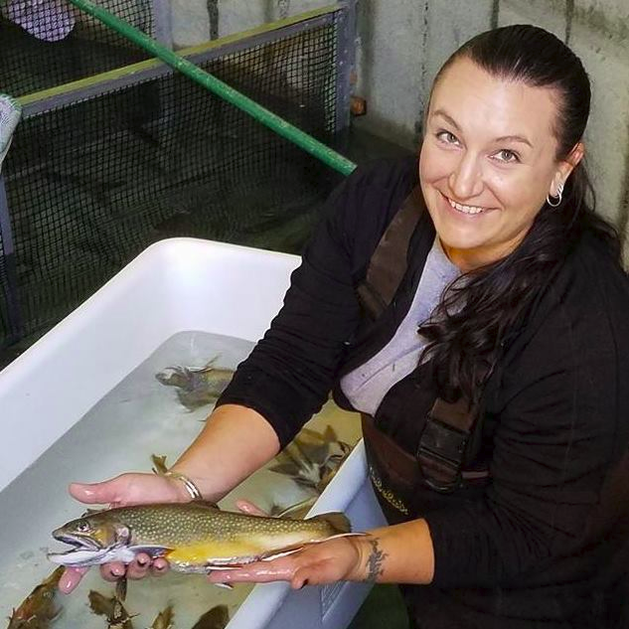
AFS Fan Mail…
“Being a part of the AFS community means having access to the professional network, tools, and knowledge needed to address the complexities of fisheries conservation.”
-Jesse Trushenski
Spring Salmon LLC
Bozeman, MT
2019 AFS President
Notes:
“Being a part of the AFS community means having access to the professional network, tools, and knowledge needed to address the complexities of fisheries conservation.” says Jesse Trushenski, from Bozeman, Montana.

Slide 20
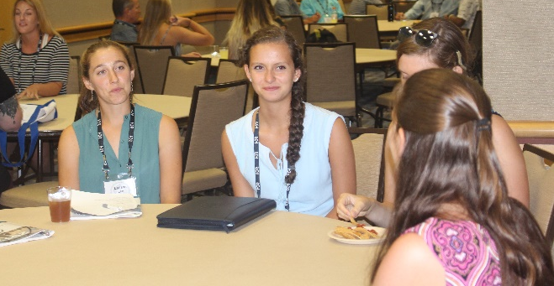
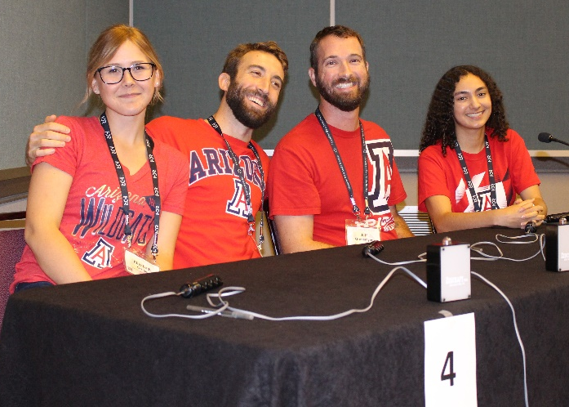
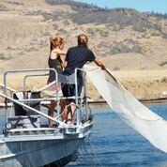
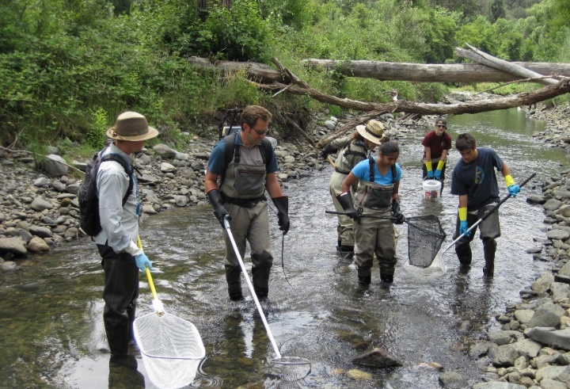
How Can AFS Help Me Give Back to the Fisheries Community?
Join a committee or volunteer for section leadership
Help mentor young professionals during student events at live events
Apply to mentor a Hutton student
Notes:
Remember that AFS as an organization is dependent upon volunteers for continuity. We depend on volunteer leadership to set the course of the organization! As a new member, we know that it can seem intimidating to become involved for the first time with “several thousand of your closest friends”. Suggestions for becoming involved towards the beginning of your membership with AFS include joining a committee or mentoring a student at a local or national event. Your commitment ensures the future of the Society, the profession, and the quality of aquatic resources for future generations.

Slide 21
We Look Forward to Having You Aboard as an AFS Member!
For Additional Information, contact AFS Membership!
membership@fisheries.org
301-897-8616
https://fisheries.org/membership/
Eva Przygodzki
Manager of Membership and Engagement
Erin Del Collo
Membership Coordinator
Notes:
With all of this in mind and as we approach the 150th anniversary of the Society, we look forward to having you aboard as an AFS member! Additional information regarding membership is available on the AFS website, or feel free to contact our membership team.

Slide 22
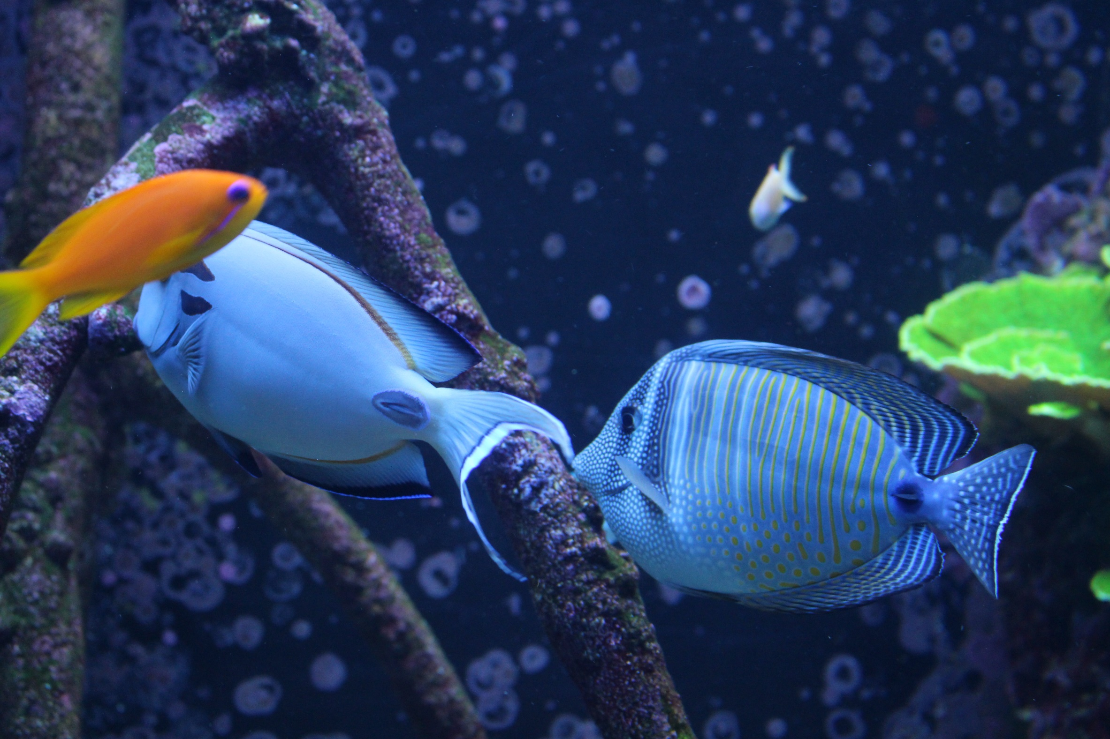
Thank you!
Notes:
In closing, we thank you again for giving us a few minutes of your time today. Enjoy the rest of your time with your chapter!

